Slide 1
Achieving Zero-Carbon Buildings: Electric, Efficient and Flexible
Key messages pack
Long

Slide 2
The building decarbonisation challenge

Slide 3
Buildings account for 33% of global emissions; around three-quarters of this relates from energy use to operate buildings, a quarter is from the annual construction of new buildings
Global emissions by sector, 2022
GtCO₂
Emissions from buildings operational energy use
Direct use of fossil fuels in buildings (e.g., gas and oil boilers and stoves)
Indirect use of fossil fuels used to generate electricity to power, heat and cool buildings
Direct
26% - 9.7 GtCO₂
60%
~250 billion m²
Current stock of global buildings
Other
Indirect
12.3
GtCO₂
Embodied carbon from new building construction
7% -
2.6 GtCO₂
Embodied emissions arise from the production of materials (e.g., cement, steel, and aluminium) and the energy used to construct buildings
~5 billion m²
a year
Annual additions to global building stock - ~2% growth
Embodied carbon from construction of new infrastructure
6% - 2.3 GtCO₂

Slide 4
The direct use of fossil fuels in buildings accounts for ~40% of energy use, followed by electricity at 35%, and the traditional use of biomass for cooking at 20%
Global buildings operational energy use by end-use and fuel, 2022
TWh
Total buildings energy use ~37,000 TWh
16,700
10,200
2,200
1,800
6,000
TUOB
Renewables
District Heat
Electricity
Fossil fuels
Gas
Oil
Coal
Heating
Cooking
Cooling
Lighting
Appliances
Share of:
Buildings energy use
Buildings direct
fossil fuel use
6%
5%
45%
28%
16%
<2%
<2%
80%
15%
<5%
Note: Shares of building energy by end use from 2021 applied to 2022 actuals. Heating includes both space and water heating.
Source: Systemiq analysis for the ETC; IEA (2022), World Economic Outlook 2021; IEA (2023), World Economic Outlook 2022.

Slide 5
Cement, concrete and steel account for 95% of embodied emissions relating to material production
Cement and steel contribution to global construction material carbon impact
% of total
Cement and concrete
Steel
Others (bricks, aluminium, glass etc)

Slide 6
Global floor area is set to increase 50–60% by 2050, driven by a doubling of the building stock in middle- and low-income countries
Growth in global floor area, projections to 2022 to 2050
Billion m²
Other middle- and low-income countries
Commercial
China
Residential
High-income countries
+55%
390
390
+100%
+55%
250
250
+55%
+20%
+35%
2022
2050
2022
2050

Slide 7



“Commercial buildings” refers to a very large and heterogenous group of sectors including schools, hotel and retail; offices only account for 25–40% of building stock
Built floor area by residential / commercial, 2015
% of total floor area
Commercial buildings by sector
% of total floor area for the US and China, % of number of buildings for Europe
0%
20%
40%
60%
80%
100%
Romania
Offices
Italy
Education
Spain
China
Schools, universities, research labs
Cyprus
Slovakia
Croatia
Wholesale and retail
United States
Incl. Shops, hairdressers, service stations, food shops
Czech Republic
Bulgaria
Latvia
Warehouses and other
Malta
Portugal
Incl. transportation and garages, agricultural buildings
Luxembourg
Hungary
Hotels and restaurants
France
Lithuania
Incl. cafes, pubs, canteens in businesses
Austria
Netherlands
Belgium
Healthcare
Ireland
Hospitals, care homes
Sweden
Poland
Greece
Sports/entertainment
Denmark
Slovenia
3%
Gyms, leisure centres, swimming pools
Germany
US
Europe
China
Finland
% of total floor space (2021)
% of number of buildings (2015)
% of total floor space (2015)
Residential
Commercial
Note: For the US, sports facilities are included in “warehouses and other”.
Source: National Renewable Energy Laboratory (2022), US Building Stock Characterization Study; Building Performance Institute Europe (2015), Europe’s Buildings Under the
Microscope; Baijiahao (2018), Real estate and constructions: What are the sub-sectors? What are the sizes?; Eurostat, available at
www.building-stock-observatory.energy.
ec.europa.eu/database/. [Accessed 01/08/2024]; US Energy Information Administration (2018), Commercial Buildings Energy Consumption Survey; Pan L, Zhu M, Lang N, Huo
T. (2020), What Is the Amount of China's Building Floor Space from 1996 to 2014?

Slide 8
Section A: Decarbonising the energy used to operate buildings

Slide 9
Heating

Slide 10
The net-zero transition will require buildings to become lower-carbon, more efficient and more flexible in their energy consumption habits
Clean heating technologies
Three sets of technologies are required to create…
Low-carbon…
Resistive heating
Solar thermal
Low-carbon fuels
Technologies to shift energy consumption outside of peak times
Technologies to reduce total energy consumption
Heat pumps
Passive heating
Stationary batteries
Water tanks
Thermal batteries
Insulation
Rooftop solar PV*
Smart systems
… buildings
Efficient…
and Flexible
Note: *Rooftop solar PV does not reduce overall energy consumption from buildings, but reduces imports from the grid.
Source: Systemiq analysis for the ETC.

Slide 11
Heat pumps are 3–5 times more efficient than gas boilers, while resistive heating converts 100% of electric energy to heat
Efficiency (primary energy to final energy) of space heating technologies
%
Fossil fuel technologies
Oil boiler
50–95%
Gas boiler
60–95%
Air source heat pump
250–500%
Electric technologies
Ground source
heat pump
300–550%
Resistive heating
100%
Hydrogen boiler
90%
Other technologies
Biomass
80-90%
Solar thermal hot water
70-80%
Efficiency (%)
Note: The efficiency of heat pumps depends more on the differential between the outside temperature and desired indoor temperature than technical efficiency, resulting in a huge range of possible efficiencies.
Source: Systemiq analysis for ETC; IEA (2022), Future of Heat Pumps; IRENA (2022), Heat Pump Market and Costs; IEA (2023), Energy Efficiency Database.

Slide 12

The competitiveness of electric heating technologies depends massively on the relative cost of gas and electricity prices
2023 average European prices:
Gas: €0.12/kWh
Electricity: €0.29/kWh → 2.5x more expensive
Equivalent annual cost of ownership (technology, installation and running costs) – Europe
€ per year
Running cost (average European
gas and electricity prices)
Range of running costs in Europe, based on highest and lowest gas/electricity prices in 2023
Upfront cost
Gas boiler
Oil boiler
Air-to-water heat pump
Air-to-air heat pump
Networked ground source heat pump
Resistive heating
Efficiency
90% | 90% | 300% | 350% | 500% | 100%
Note: Assumes an average heat demand of 11,500 KWh a year per household, based on an average across the US and select European countries. Average, min and max running costs are based on 2023 retail prices. Assumes 5% discount rate. Excludes subsidies and maintenance costs. Networked ground source heat pumps – we assume a €50 a month standing charge fee for the shared ground arrays.
Source: Systemiq analysis for the ETC; Eurostat Database, available at www.ec.europa.eu/eurostat/data/database. [Accessed 01/08/2024].

Slide 13
The smaller the differential between gas and electricity prices, the lower the efficiency that a heat pump needs to achieve for cost parity
Equivalent annual costs (technology, installation and running costs) at different electricity to gas price ratios
€ a year
A 2:1 price ratio would make heat pumps cost competitive at a COP of 2.7, as opposed to 3.4
European average today (2.5:1)
With a 2:1 ratio
With a 1.5:1 ratio
With a 4:1 ratio
Gas
Example country ratios
United Kingdom
Belgium
Germany
Italy
United States
France
Netherlands
Portugal
Sweden
Note: Assumes an average heat demand of 11,500 KWh a year per household, based on an average across the US and select European countries. Fuel prices reflect averages from 2023. Assumes a discount rate of 5%.
Source: Systemiq analysis for the ETC; Eurostat Database, available at: https://ec.europa.eu/eurostat/data/database. [Accessed 01/08/2024].

Slide 14
Passive heating

Slide 15
Passive techniques in new buildings can reduce heating energy consumption by 15–30% on average
Impact on annual heating energy consumption of passive heating techniques
%
Rate of return (assessment of developer costs and household energy bill savings in Europe)
Expected average cost to developer
Building envelope
0%
10%
20%
30%
40%
50%
Airtight membranes
and tapes
Low
$500–2,000
High
20%
Medium
$2,500–5,000
Medium
5%
Double glazing
Medium
$500–1,500
High
30%
Cavity wall, loft and
floor insulation
High
$1,000–5,000
High
30%
External wall insulation
Building fabric
Walls with
thermal mass
High
$2,500–10,000
Low
<5%

Slide 16
3 aspects to creating “net-zero ready” buildings: all buildings must have clean heating and smart/flexible technologies, and assess the most appropriate building fabric improvements
Install clean heating technologies
Improve building fabric
Install smart and flexible tech
Possible interventions
Heat pumps, resistive heating
Insulating walls (internal, external, cavity), lofts and ceilings, double glazed windows, draught proofing, ventilation improvements
Solar PV, batteries, smart systems
New buildings
All buildings in high-income countries from 2025.
In other countries, from 2035
All buildings should be built to much higher energy efficiency standards – the additional cost to developers of achieving a 20% reduction in kWh/m² is typically around 1-5%, which can often be recouped via a higher selling price
All buildings in high-income countries should be smart-ready and solar-ready
Existing
buildings
All buildings by the early-mid 2040s in high-income countries.
In other countries, the aim should be 2050.
With falling costs, rooftop solar PV and smart systems offer huge opportunities to lower energy bills
Time of use tariffs are needed to incentivise investment in batteries and water storage
Inefficient buildings
Average building
Light retrofit: easy to access improvements (e.g., low-cost or less disruptive)
All buildings should explore low-cost measures
✔
✔
Medium retrofit: 2-4 interventions
✔
Most buildings can take a balanced approach to further insulation; deep retrofit is not a pre-requisite for a heat pump in the average house
✔
Deep retrofit: package of whole-house interventions
✔
Retrofitting the least efficient buildings must be a government priority

Slide 17
Implications for technologies and energy demand

Slide 18
While it is not possible to estimate an exact tech mix, there is huge value in understanding the broad trajectory of clean heating technologies to guide policy, investment and skills
Illustration of probable dominant space heating technologies across different building archetypes and ownership – UK
% of stock in 2050
New build
(owned or
rented)
Owned
Rented and social: Relies on strong regulatory and financial action to ensure low-cost but low efficiency resistive heating isn’t dominant
Rented
Social
Flat
Terraced
Semi-detatched
Detatched
District heating
Network ground source heat pump
Resistive
Air to air heat pump
Air to water heat pump
Ground source heat pump

Slide 19
While it is not possible to estimate an exact tech mix, there is huge value in understanding the broad trajectory of clean heating technologies to guide policy, investment and skills
Illustration of probable dominant space heating technologies across different building archetypes and ownership– France
% of stock in 2050
New build
20
Owned
Rented
Social
Flat
Semi-detatched
Detatched
District heating
Network ground source heat pump
Resistive
Air to water heat pump
Ground source heat pump
Air to air heat pump

Slide 20
In Europe and the United States, 95% of gas boilers could be phased out by the early 2040s, with no more gas boilers to run by 2045
Building heating technology stock
% of stock of technologies in individual homes
Gas
Oil
Electric technologies
Indicative 2050 mix
The vast majority will be
transitioned to various types
of heat pumps
A share can be transitioned to
district heat networks, the vast
majority of which will be
powered by heat pumps
Resistive heating, where heat
pumps are unfinanceable,
unsuitable, or unpreferable
2022
2030
2035
2040
2045
2050
Europe
US
95% of gas boilers phased out early 2040s
No more gas boilers to run
No new gas boiler installations
Source: Systemiq analysis for the ETC; IEA (2022), World Energy Outlook 2022; IEA (2023), World Energy Outlook 2023; IEA (2023), World Energy Balances dataset; IEA (2023),
Energy Efficiency dataset; Tsinghua Building Energy Research Center, Annual Report of Building Energy in China.

Slide 21
Electricity demand from heating could be 4 times higher than it is today, but with strong action on energy productivity, the increase could be less than double
Global final energy demand for heating by fuel in 2050
TWh
-50%
16,500
Note: other includes district heating, which will also be majority powered by electricity in 2050
-10%
14,800
Other
3,100
-15%
4,000
12,700
Electricity in
individual buildings
2,600
4,000
-40%
x4
8,000
Fossil in
individual buildings
2,800
10,800
10,300
8,000
4,600
500
700
600
2022
2050 - baseline
2050 - with technical efficiency improvements of heat pumps
2050 - with technical efficiency improvements AND better new buildings, retrofit and demand efficiency
Note: Other includes district heating and renewables.
Source: Systemiq analysis for the ETC; IEA (2023), World Energy Outlook 2023; IEA (2021), Net Zero by 2050.

Slide 22
Cooling

Slide 23
Cooling is the fastest growing operational end-use, with global cooled floor area set to overtake heated floor area by 2050
Space cooling (residential + commercial) energy consumption by region, IEA baseline scenario, 2022-50, TWh
Heated floor area vs. cooled floor area (residential + commercial), IEA Net Zero scenario Billion M²
Europe
China
India
Mexico
Middle East
Cooled floor area
US
Japan and Korea
Indonesia
Brazil
Rest of world
Heated floor area (space heating)
5,200
Cooled floor area is growing at a higher rate than heated, driven by 1) GDP per capita growth; 2) increase in building floor area, particularly in developing economies; 3) warming climates
150%
+150%
+25%
2,100
150
100
2022
2050
2022
2050
Rapid growth in cooling demand in countries with carbon-intensive electricity grids highlights the importance of rapidly scaling up renewables across the world.

Slide 24
Passive techniques can reduce cooling energy consumption in buildings by 25–40% on average and many of these are very low-cost, such as painting roofs white and planting trees
Impact on annual cooling energy consumption of passive cooling techniques
%
0%
10%
20%
30%
40%
50%
60%
70%
80%
90%
100%
Expected cost to developers
Natural ventilation
Low
$1,000–3,000
Building design
Wall insulation
The cost and impact of passive cooling techniques varies massively depending on:
Climate
Labour and material costs in different countries
Extent of technique deployed (e.g., external shading can range from trees and retractable awnings to concrete structures)
Medium
$1,500–4,500
Reducing window to
wall ratio from 100% to 25%
High
$10,000–30,000
External shading
Medium
$2,000–7,000
Material and colour choices
Double-glazed south-
facing windows
Medium
$5,000–10,000
Low
$500–2,000
White-painted roof
Walls with thermal
mass
High
$10,000–30,000
City design and site adaptation
Creating green space
Medium
$2,000–10,000
Vegetation-based wall
High
$10,000–30,000

Slide 25
Improving the technical efficiency of AC and deploying passive cooling techniques in new buildings could more than offset the increase in electricity demand - but relies on strong policies
Global electricity consumption from cooling, 2020 to 2050
Annual TWh
3,100
5,200
x2.5
-75%
2,100
-2,600
1,200
-1,400
Electricity consumption, 2022
Increased demand to 2050
Electricity consumption in
2050, holding today's
technical and building
efficiency constant
Technical efficiency improvements
Better new
buildings, retrofit for
passive cooling, and
behavioural choices
Electricity
consumption,
2050 - lower
bound

Slide 26
Cooking

Slide 27
High-carbon cooking fuels are also the least efficient; electric induction hobs are by far the most efficient cooking technology
Energy efficiency of cooking fuels and technologies
%
In hot countries with a cooling need, the impact of low efficiency TUOB and gas on electricity use is further exacerbated by increased fan or AC electricity needs to offset the heat produced
Traditional use of biomass
(TUOB) and coal
10
20
Improved cookstoves
20
50
Natural gas, LPG and biogas
40
60
Electric conductive
70
80
Induction
80
90

Slide 28
The transition from inefficient biomass to electric cooking will more than halve final energy demand for cooking, but this could increase electricity demand 7-fold relative to today
Global cooking energy demand by fuel, 2022 and 2050
TWh
15,300
Bioenergy
TUOB
Coal
+50%
Oil
Gas
10,200
-70%
Electricity
Renewables
4,900
4,400
-15%
4,000
3,500
550
850
2022
2050 - increase in
demand and holding
technology mix constant
2050 - with
transition to electric
technologies
2050 - with transition to electric
technologies and efficiency
improvements
Note: TUOB = Traditional use of biomass.
Source: Systemiq analysis for the ETC; IEA (2023), A Vision for Clean Cooking for All.

Slide 29
Lighting and appliances

Slide 30
LEDs are the leading lighting technology, but only account for half of global sales; with well-designed policies and incentives, this could be 100% by 2030
Global lighting efficacies
Lumens per Watt
Global residential lighting sales share by technology
Proportion of sales (%)
+30% projected
efficiency gain
Other lamps
If current trends continue, LED sales could be 100% of new lighting sales by 2035; but policy should aim to achieve this by 2030
LEDs have become more efficient than any other economically viable alternative
LED
Higher efficiency
LEDs
Linear
fluorescents
Compact
fluorescents
(CFLs)
Halogens
Incandescents
2010
2015
2020
2030
2010
2015
2020
2022
2030

Slide 31
With regulation to phase out inefficient non-LED lightbulbs and continued improvements to LEDs, efficiency improvements could more than offset the rise in demand for lighting
Global annual lighting electricity consumption, 2022 to 2050
Annual TWh
1,800
3,600
-55%
-1,500
1,600
-500
2022
Demand increase
2050 - at current average lighting efficiency
2050 - assuming all lighting is LED
2050 - assuming LEDs get even more efficient
Potential electricity consumption in 2050
Global average lighting efficiency
80 lm per watt
110 lm per watt
140 lm per watt

Slide 32
Commercial buildings

Slide 33
Energy needs vary significantly across different types of commercial building meaning there is no one-size-fits-all decarbonisation pathway
Energy intensity by subsector and energy end-use in the US, 2018
kWh per M² per year
Space heating
Water Heating
Space cooling
Cooking, lighting, appliances
Food sector is the most energy intense, due to cooking energy use and small premises
Restaurants
Hospitals have complex and high overall energy needs
Healthcare
Space heating and cooling needs are roughly equal, depending on the time of year
Wholesale and retail
Very large water heating needs and lighting and appliances
Hotels
Space heating needs dominate, while energy intensity is low given large spaces
Education
Offices
Low water heating needs, high lighting and appliance needs
Warehouse
Due to their large footprint, offices and warehouses are the least energy intense commercial sector
Residential
(gas for heating)
For reference, a typical US household uses ~100 kWh per M² a year

Slide 34
There is currently no correlation between green building certifications and energy performance of commercial buildings
Energy use intensity of office buildings in Europe and the United States, by green building certification status
kWh per M² per year
Certified buildings
Non-certified buildings
2022
Source: LOTUF (2024), Seeing is Believing: Unlocking the low-carbon real estate market.

Slide 35
Refrigerant leakage

Slide 36
There are two ways to reduce harmful refrigerant emissions – a) reduce how much refrigerant is released into the atmosphere, and b) transition to low GWP refrigerant
What are refrigerants?
What is the challenge with refrigerants?
Found in AC and heat pumps, refrigerants contribute to climate change if leaked and/or vented. Refrigerants differ in their global warming potential (GWP):
Leakage
A small amount of refrigerant typically escapes from AC and heat pump systems through leaks or improper handling.
Key risk factors include:
Older or poor quality equipment
Poor quality of installation
Lack of maintenance
Venting
Refrigerant is often intentionally released into the atmosphere during servicing and at end-of-life.
Key risk factors include:
Improper servicing practice
Lack of training and awareness of technicians
Improper disposal
HFCs (Hydrofluorocarbons)
Most commonly used
GWP
Industry transition
R-134a
1430
Driven by the 2016 global Kigali Agreement to phase out high GWP HFCs
90%+
of refrigerant at end of life
R410a
2088
2–5%
a year
R-32
675
Low-GWP HFOs (Hydrofluoroolefins)
Alternatives to HFCs
R1234ze
7
Natural Refrigerants
Emerging solutions
CO2
1
Propane
3
Ammonia
0

Slide 37
Emissions from refrigerant leakage and venting could reach 2 GtCO₂ in 2050, but could be 50% lower with regulation on proper disposal and a transition to low-GWP refrigerant
Scenarios of potential annual global emissions relating to refrigerant leakage and venting
GtCO₂e
AC
Heat pumps
2050 total
2.3
-0.9
-0.6
Key policies:
0.7
Regulation to ban use of hydrofluorocarbons
Skills accreditation + regulation for proper disposal
2024
Increase in heat pumps + AC installations
2050 (assuming no transition to low-GWP refrigerant)
Transition to low-GWP refrigerant
Lower venting rates (from 90% to 50%) + leakage rates (from 3.5% to 1.5% a year)
Potential 2050 total
Equivalent to… of current building emissions (12.3 GtCO₂)
5%
20%
<10%

Slide 38
Flexible and efficient buildings

Slide 39
Heating needs peak in the evening and during the winter months in Northern latitude countries, while solar generation peaks in the middle of the day and during summer
Hourly electricity demand, Great Britain, a week in January 2050
GW
Annual electricity demand and renewable supply, Great Britain, 2050
GW, averages over a week
Heating
Heating
Wind
Transport
Total
Solar PV
Commercial and industrial
Appliances
^{00:00}
^{20/01}
^{12:00}
^{00:00}
^{21/01}
^{12:00}
^{00:00}
^{22/01}
^{12:00}
^{00:00}
^{23/01}
^{12:00}
^{00:00}
^{24/01}
^{12:00}
^{00:00}
^{25/01}
^{12:00}
^{00:00}
^{26/01}
^{12:00}
^{Jan}
^{Feb}
^{Mar}
^{Apr}
^{May}
^{Jun}
^{Jul}
^{Aug}
^{Sept}
^{Oct}
^{Nov}
^{Dec}

Slide 40

Cooling needs tend to peak in the middle of the day and nighttime; AC is required all year round, but solar generation falls significantly during the Monsoon months
Hourly electricity demand, India, a week in January 2050
GW
Daily electricity demand and renewable supply, India, 2050
GW, averages over a week
1,300
Wind
Total demand
Monsoon season between June-September
1,200
Solar
1,100
1,000
900
800
700
600
500
400
300
200
100
0
^{00:00}
^{20/01}
^{12:00}
^{00:00}
^{21/01}
^{12:00}
^{00:00}
^{22/01}
^{12:00}
^{00:00}
^{23/01}
^{12:00}
^{00:00}
^{24/01}
^{12:00}
^{00:00}
^{25/01}
^{12:00}
^{00:00}
^{26/01}
^{12:00}
^{Jan}
^{Feb}
^{Mar}
^{Apr}
^{May}
^{Jun}
^{Jul}
^{Aug}
^{Sept}
^{Oct}
^{Nov}
^{Dec}

Slide 41
Creating efficient and flexible buildings will play a key part of managing household electricity demand in an energy system of variable renewables
Reduce energy needs and losses
1
2
3
Use less energy for the same output
Household demand-side flexibility
Technical efficiency improvements
Better building design and retrofit
Smart systems
Solar PV
Storage solutions
Impact on final energy consumption
More efficient technologies consume less energy
Passive heating/cooling reduces energy needs, and insulation reduces energy loss
Optimise energy consumption according to need and incentivise household behaviour change
Reduces electricity imports from the grid
Only able to time shift demand - does not reduce the amount of energy needed
Impact on peak energy consumption
Reduces scale of peaks, but unable to load-shift
Enables households to pre-heat their homes ahead of peak times
Automatically time shift energy consumption based on needs in response to peak prices
Unable to time-shift demand – unless combined with a battery
Batteries, hot water storage, or heat storage enable time shifting of energy use to off-peak times
Source: Systemiq analysis for the ETC.

Slide 42
Building codes should move towards certification level over time, driving the industry frontier forward, while the Passive House standard defines the technical potential
Country with long established building energy codes
Passive House standard
Building codes – minimum standard
Certifications – top 5% of the market
Illustrative
Energy efficiency of new builds
Today
2040
Manageable, gradual cost premium to meet rising standards
Certifications push industry frontier
Country with no established building energy codes
Illustrative
Typical range of new construction
Today
Building code
Certifications
2040
Regulation must be gradually phased in and tightened over time for cost premiums to be feasible

Slide 43
Homes vary significantly in terms of their ability to retain heat, with big implications for the ability of households to “pre-heat” their homes ahead of peak needs
Home temperature loss after 5 hours
ºC
United Kingdom
Belgium
France
Netherlands
Spain
Italy
A building’s “hours of flexibility” is determined by its:
Thermal mass: building fabric’s ability to slowly absorb, store and radiate ambient heat, avoiding sudden spikes in temperature → bricks, stone, concrete
Heat loss rate: insulation which creates a barrier between hot and cold temperatures → fibreglass, foam, mineral wool
Austria
Denmark
Sweden
Germany
Norway
Note: Tested in 2019/20 with a temperature of 20°C inside and 0°C outside.
Source: Tado, UK homes lose heat up to three times faster than European neighbours, Available at www.tado.com/gb-en/press/uk-homes-losing-heat-up-to-three-times-faster-than-european-neighbours?. [Accessed 01/08/2024].

Slide 44
Rooftop solar PV will be a key solution in commercial buildings with large roof space relative to floor space (e.g., warehouses)
Average hourly winter energy use, by commercial building – Europe
kWh
Electricity - heat pump
Electricity - other
Solar PV
Small hotel – roof space: 1,000 M², 4 floors
Large office – roof space: 3,500 M², 12 floors
Less likely to install solar PV
0.14
1.4
Small roofs relative to floor space (roof : floor ratio <20%)
Roof space further limited by HVAC equipment
Solar PV can meet:
  ~10% of needs in small hotel
  ~1% of needs in large office
0.12
1.2
0.10
1.0
0.08
0.8
0.06
0.6
0.04
0.4
0.02
0.2
0.00
1
3
5
7
9
11
13
15
17
19
21
23
0.0
1
3
5
7
9
11
13
15
17
19
21
23
Secondary school – roof space: 12,000 M², 2 floors
Warehouse – roof space: 2,100 M², 1 floor
Highly likely to install solar PV
0.8
0.14
Warehouses have a 100% roof to floor ratio
Solar PV can meet:
  25% of needs in secondary school
  35% of needs in warehouse
0.7
0.12
0.6
0.10
0.5
0.08
0.4
0.06
0.3
0.2
0.04
0.1
0.02
0.0
1
3
5
7
9
11
13
15
17
19
21
23
0.00
1
3
5
7
9
11
13
15
17
19
21
23
Note: Winter is defined as November to February.
Source: Systemiq analysis for the ETC; Schneider Electric Sustainability Research Institute.

Slide 45
Electrification, technical efficiency gains, and improving building fabric could reduce final energy demand by 60%
Impact of energy productivity on final energy demand in 2050 – residential + commercial buildings
TWh
Heating
Lighting
Cooking
Cooling
Appliances
Total building
20,900
57,500
-30%
-60%
36,600
-16,100
-11,400
-3,600
-1,700
23,000
-1,500
2022
Activity - new
buildings and
additional
demand
2050 energy
consumption
without
decarbonisation
Electrification
Technical efficiency improvements
Better building codes
Fabric improvements to existing buildings
Behavioural
choices
2050 - with
decarbonisation
and enegy
productivity
Note: The increase in activity to 2050 includes both an increase in fossil fuel energy use (e.g., new fossil fuel boilers and cookers largely in lower-income countries) and new
electric heating and cooking appliances, largely in high-income countries and China. The electrification lever then refers to the transition of the existing stock of fossil fuel
heating and cooling to clean technologies.
Source: Systemiq analysis for the ETC; IEA (2023), World Energy Outlook 2023; IEA (2021), Net Zero by 2050.

Slide 46
Global electricity demand could more than double by 2050 from 13,000 TWh to over 35,000 TWh – but strong action on energy efficiency could cut this in half to ~19,000 TWh
Electricity demand in 2050 and impact of efficiency levers – residential + commercial
TWh
Heating
Lighting
Cooking
Cooling
Appliances
Total building
10,700
35,500
-50%
x2.5
12,000
-11,400
5,500
18,600
Note: just considers the transition of individual fossil fuel boilers to heat pumps or resistive; additional electricity will be required to power district heating
12,800
2022
Population, income and floor space growth
Transition to electric technologies
2050 - baseline
Technical efficiency improvements
Better new buildings, retrofit, and demand efficiency
2050 - with action on energy productivity
Source: Systemiq analysis for the ETC; IEA (2023), World Energy Outlook 2023; IEA (2021), Net Zero by 2050.

Slide 47
The direct use of fossil fuels in buildings could be virtually eliminated by 2050, with a reduction of 15% by 2030 and 75% by 2040 as heating and cooking electrify
Fossil fuel demand in buildings, projections to 2050
TWh
13,600
-15%
11,500
Gas
-75%
-95%
3,300
Oil
Coal
500
2022
2030
2040
2050
Source: Systemiq analysis for the ETC; IEA (2022), World Economic Outlook 2022; IEA (2023), World Economic Outlook 2023; IEA (2023), World Energy Balances dataset; IEA
(2023), Energy Efficiency dataset; Tsinghua Building Energy Research Center (2014), Annual Report of Building Energy in China..

Slide 48
Section B: Embodied carbon

Slide 49
Understanding emissions across the building lifecycle

Slide 50
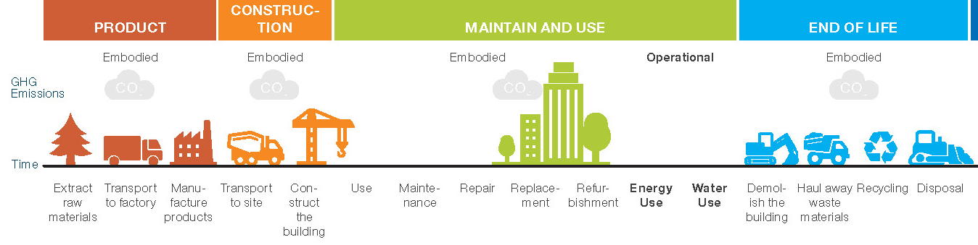
Embodied carbon refers to the emissions arising from the construction, maintenance and demolishing of buildings
Sources of embodied and operational emissions across the building life cycle
A. Upfront phase
B. Maintenance and use phase
C. End of life phase
Construction
Product
Type of building emissions
Embodied
Embodied
Embodied
Operational
Embodied
Time
Extract raw materials
Transport to factory
Manu-facture products
Transport to site
Con-struct the building
Use
Mainte-nance
Repair
Replace-ment
Refur-bishment
Energy use
Demol-ish building
Haul away waste materials
Recycling
Disposal
Fuel + process emissions from producing building materials (e.g., steel, cement and concrete)
Fossil fuels used in factories and transportation
Fossil fuels used for machinery and transportation
Material production
Emissions relating to the production of new heating systems and equipment
Heating
Cooling
Cooking
Lighting
Appliances
Fossil fuels used for:
Demolition and machinery
Transportation of waste
Recycling or disposal processes

Slide 51
Embodied emissions are large, one-off bursts of emissions at a few points in a building’s lifecycle; operational emissions occur every year a building is in operation
Whole life carbon emissions – Europe
kgCO₂e per m²
There is a lack of data and no consensus on the level of embodied carbon emissions globally today
European case studies suggest that embodied carbon accounts for ~50% of a building’s lifecycle emissions – but this can vary across countries depending on the carbon intensity of the grid, heating technology, and materials used
The vast majority of embodied carbon emissions are in the upfront stages (product + construction)
Upfront embodied
Share of total lifecycle emissions over 60 years
Maintain and use embodied
End of life embodied
Operational
2%
0
10
20
30
40
50
60
Years

Slide 52
Steel, cement and concrete drive embodied carbon across all building layers; a building’s structure accounts for half of total upfront emissions
Concrete / cement
Steel content
Steel
Other materials dominate
Estimated upfront embodied carbon by building layer - Europe
kgCO₂e per m²
Concrete/cement content
400
120
80
160
Internal walls
HVAC Systems
External walls (bricks + cement)
Concrete / cement
Doors (metal or timber)
Electrical (wiring, lighting)
Doors (metal or timber)
Finishes (paint, tiles)
Steel
Windows (glass + metal frames)
Public health (plastic)
Building layer
Structure
Skin
Space plan
Services

Slide 53
Addressing process and production emissions will have the biggest impact on embodied carbon, but reducing material demand is also critical to achieve net-zero by 2050
1.5ºC aligned pathways to net-zero
GtCO₂ per year
Low-carbon technologies
Demand efficiency levers (construction)
Demand efficiency (other industries)
Cement and concrete
Unabated emissions
Steel
4.0
3.5
3.0
2.5
2.0
1.5
1.0
0.5
CDR offsets will be required to reach net-zero
0.0
2020
2030
2040
2050
2020
2030
2040
2050

Slide 54
A suite of low-carbon cement and concrete technologies are available today, including CCUS which will likely account for 40% of cumulative mitigation potential to 2050
1.5ºC aligned pathways to net-zero in cement and concrete
GtCO₂ per year
4.0
Reducing process emissions
Efficiency in concrete production: using less clinker per unit of cement
by using less emissions-intensive supplementary cementitious
materials (SCMs)
3.5
Savings in cement and binders: using less cement per unit of concrete
by increasing strength of cement and using low-carbon chemistries
(e.g., alternative binders)
3.0
2.5
Bringing production emissions close to zero
2.0
Fuel switching and energy efficiency: addressing heat emissions
through thermal efficiency and replacing fossil fuels with waste and
biofuels, hydrogen, or electrification
1.5
CCUS – carbon capture, utilisation and storage
Decarbonisation of electricity
1.0
Reducing demand for concrete/cement
Demand efficiency: improving building design,
extending building lifespans, increasing the use of alternative materials,
and reusing certain elements of concrete
0.5
0.0
2020
2030
2040
2050
Recarbonation: concrete reabsorbs CO₂ over its lifetime
Unabated

Slide 55
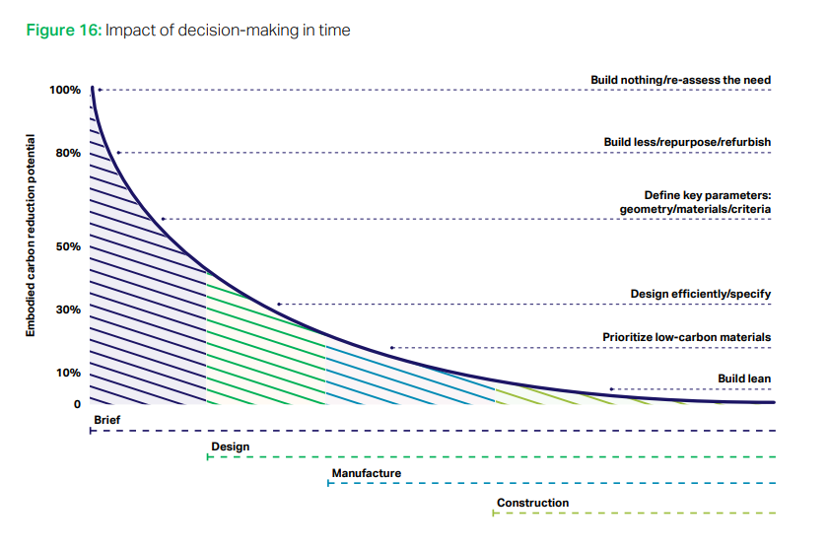
The biggest opportunity to reduce embodied carbon is to build less in the first place; but there are many ways to “build clever” and “build efficient” without restricting urbanisation
Impact of embodied carbon reduction strategies
Reduction potential, %
Build nothing
Re-use or extend use of existing buildings
Build less
Optimise building use and service efficiency
Better urban planning
Build nothing
Build less
High impact – but much harder to implement
Build smarter
Material intensity
Innovative construction solutions
Material substitution
Build efficient
Efficient construction methods
Circularity approach
Build smarter
Decarbonise material production
Build efficient
Brief
Relatively lower impact – but easier to implement
Design
Material production
Construction

Slide 56
Strategies to reduce material demand, minimise waste and extend building lifetimes could cut demand for cement and steel by 30–35% to 2050
Potential reduction in cumulative demand for cement, concrete and steel to 2050
%
Cement and concrete
-35%
1
65
BAU
Build smarter
Build efficient
Build less
High efficiency
Build smarter: Building design choices;
innovative construction solutions;
material substitution
Build efficient: Efficient construction methods; circularity approach
Build less: Extend building lifetimes
Note: The impact of the levers in steel reflect the impact on total global steel demand, including construction, transport and machinery.
Source: Systemiq analysis for ETC; Mission Possible Partnership (2023), Making Net Zero Concrete and Cement Possible.

Slide 57
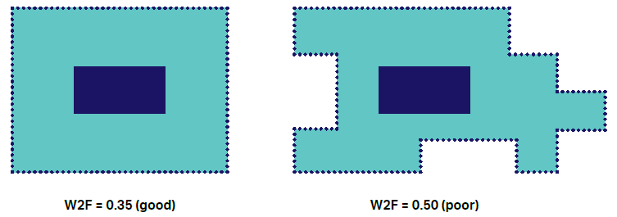
Taller buildings and those with a high wall-to-floor ratio are more embodied carbon intensive
Wall-to-floor ratio
Building height
Upfront embodied carbon of high-rise buildings in London
kgCO₂e per m² (gross internal area)
Illustrative
Wall
Floor
1,200
Highrise 2
Highrise 5
1,000
Highrise 1
800
Midrise 4
Highrise 3
600
Midrise 2
Highrise 4
Midrise 1
Midrise 3
W2F = 0.50 (poor)
W2F = 0.35 (good)
400
Lower Wall to floor (W2F), lower embodied carbon
Number of floors
Taller buildings typically require:
More structure – thicker core walls, bigger columns, larger foundations
More space and equipment – lifts and stairs
More building services
Embodied carbon per m² can be 50% higher to provide the same net useable area between high-rise and low-rise construction

Slide 58
There are many alternative materials to cement, concrete and steel, but to have a lower whole-life carbon impact, they must be sustainably sourced and dealt with correctly at end of life
Four questions determine the whole-life carbon impact of alternative materials
Key question | Risk of adverse impact on whole-life carbon
How much carbon is generated from producing the material (e.g., manufacturing and transport) | In almost all cases, carbon is lower than cement/concrete/steel. Using local materials to reduce transport emissions is key. | Low
Is the material sustainably sourced? | Bio-based material must be cut down at the optimal time and replanted. | High
Is carbon further sequestered during the building’s lifetime? | Some materials are able to further sequester carbon, in addition to storing existing sequestered carbon. | Low
How is the material dealt with at end of life? | If material is not reused, recycled or burned with carbon capture, then whole-life carbon impacts can be greater than steel and cement. | High
1
2
3
4
Low-carbon material | Description and main uses | How certain is low whole-life embodied carbon? | Current market scale | Potential to scale further
Timber | Softwood: window and door frames Glued-laminated timber: load bearing elements such as rafters, beams, slabs and columns Cross-laminated timbe: structures, walls and floors. | Low Producing timber for construction produces around 100-200 kg CO₂e/m³ - but highly variable; 50% of emissions due to transporting material to site Timber stores carbon over its lifetime in a building, but to realise benefits over concrete and steel, it crucially must be: Sustainably sourced with replanting Reused or recycled at end-of-life Or, if burned, combustion emissions must be captured | Mass market | Medium Supply of sustainability-produced timber is limited Risks of fire, rot and pests must be managed

Slide 59
Bamboo | Lightweight and strong Scaffolding, foundations, flooring, roofs, beams, walls | Medium Bamboo stores carbon over its lifetime, but must be sustainably sourced and dealt with properly at end of life 4-6 years growth cycle means bamboo sequesters carbon 1.3 times faster than tropical rainforests cycle) Can be harvested without killing the plant, allowing quick regeneration | Early stage | Medium Low durability if not treated properly – risk of pests, fungi and fire Very heterogenous material – designing standardised codes and constriction techniques is challenging
Hempcrete | Hemp, lime and water – used for walls, in combination with a structural frame due to low composite strength Able to control humidity and has high thermal inertia Hemp fibres used for insulation | High Hemp absorbs CO₂ as it grows and stores it over its lifecycle Rapid growing cycle of hemp (1/3 of a year) Carbonation of lime binder further sequesters carbon Potential for hempcrete to be carbon negative | Early stage | High Fire resistant and less susceptible to pests Hemp can be grown all over the world in different climates – supply is scalable
Rammed earth | A mixture of gravel, sand, silt, clay with a small amount of cement or lime Layers are rammed into place between flat panels which are then removed Excellent thermal mass, limited insulation Technique used for thousands of years | High Use of natural materials means very little carbon is generated in production Rammed earth can also sequester carbon over its lifetime, depending on the amount of lime and cement used However, rammed earth does use a small amount of cement; the exact carbon impact varies depending on the exact composition of material used | Mass market | Medium Natural materials in abundance Composition based on locally available materials Suitable for all climates – but requires high design skills Labour-intensive process, not suitable for modular construction

Slide 60
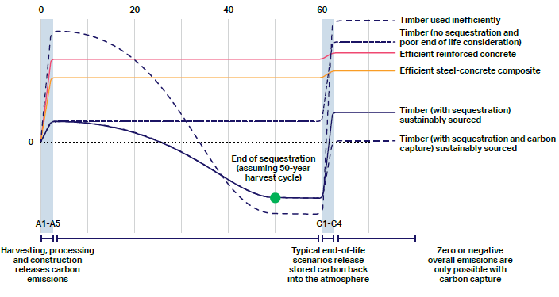
Used in the right way and with proper end of life consideration, modern engineered timber can significantly lower a building’s embodied carbon
Cumulative embodied carbon of sustainably sourced timber and timber used inefficiently
kgCO₂e/m²
Year
Timber used inefficiently
Timber (no sequestration and poor end of life consideration)
For timer to have lower lifetime emissions compared to high-carbon concrete and steel, it must be:
Sustainably sourced from standing forest which is replanted, ensuring sequestration
Dealt with properly at end of life (e.g., recycled, or burned + carbon capture)
Efficient reinforced concrete
Efficient steel-concrete composite
Timber (with sequestration) sustainably sourced
Timber (with sequestration and carbon capture) sustainably sourced
Zero or negative overall emissions are only possible with carbon capture
Harvesting, processing and construction releases carbon emissions
Timber at end-of-life can release stored carbon back into atmosphere

Slide 61
The total embodied carbon from building 140 billion m² by 2050 could be reduced by 65% with action to decarbonise material inputs and with material efficiency and substitution
Potential reduction of embodied carbon from the construction of new floor space, cumulative emissions 2023–50
GtCO₂e
Cement
Steel
Others
-50%
-10%
-60%
40
-35
30
-10
Embodied carbon from construction of new buildings, holding today’s carbon intensity constant
Decarbonising production of material inputs
Using materials more efficiently and substituting for low-carbon materials
Potential lower bound embodied carbon from the construction of new buildings

Slide 62
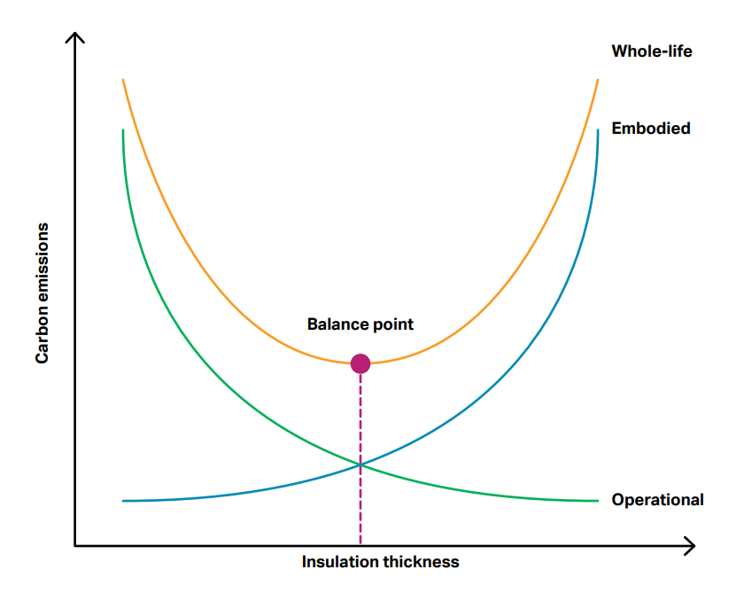
Embodied carbon from retrofitting existing buildings will be offset by avoided operational energy emissions; but as the grid decarbonises, this trade-off will become more challenging
Illustration of the balance between embodied carbon and operational carbon from insulation
Whole life
Understanding the whole life carbon from retrofitting requires weighing up embodied carbon and avoided operational emissions
Beyond a certain point, further insulation will have a negative net impact on carbon emissions
This point will shift over time, as operational emissions are decarbonised – creating trickier trade-offs for retrofit
Embodied
Carbon emissions
Embodied carbon repaid
Operational – current carbon intensity
Operational – as grid decarbonises
Insulation thickness

Slide 63
If built to the highest embodied carbon standards, lifecycle emissions from rebuilding old buildings could be as high as retrofitting
Cumulative whole life carbon emissions of a commercial building in Europe over 60 years
kgCO₂e per m²
Retrofitting building for energy efficiency
Rebuilding building to very high operational and embodied carbon standards
Upfront embodied carbon
In-use embodied carbon
Operational carbon
Total upfront embodied carbon of the rebuild scenario is 3x higher, but this will change as material production decarbonises
Operational carbon is 4x higher in the retrofit scenario
1,030
995
1,030
965
930
960
900
860
895
835
795
830
770
725
760
700
660
695
635
625
570
505
440
370
305
240
2020
2030
2040
2050
2060
2070
2080
2020
2030
2040
2050
2060
2070
2080

