Slide 1
Building Grids Faster: the Backbone of the Energy Transition
Key Messages
17 September

Slide 2
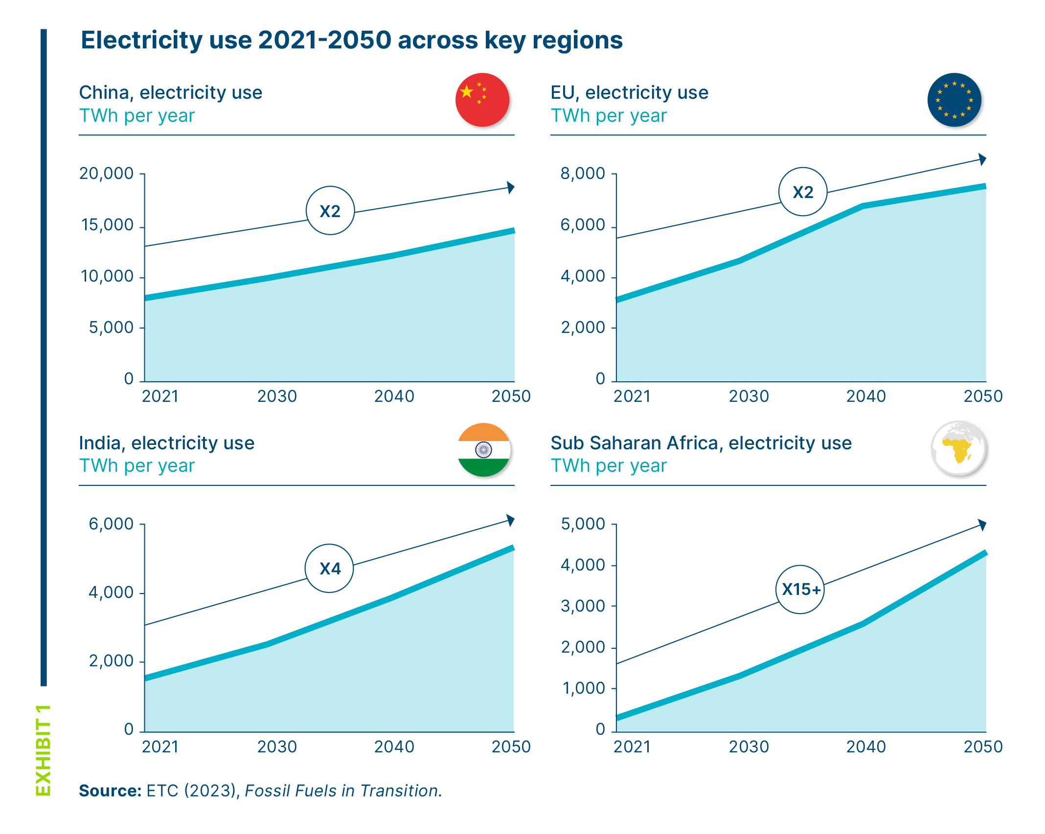
The trajectory to net-zero will require significantly higher electricity use across the world to 2050

Slide 3
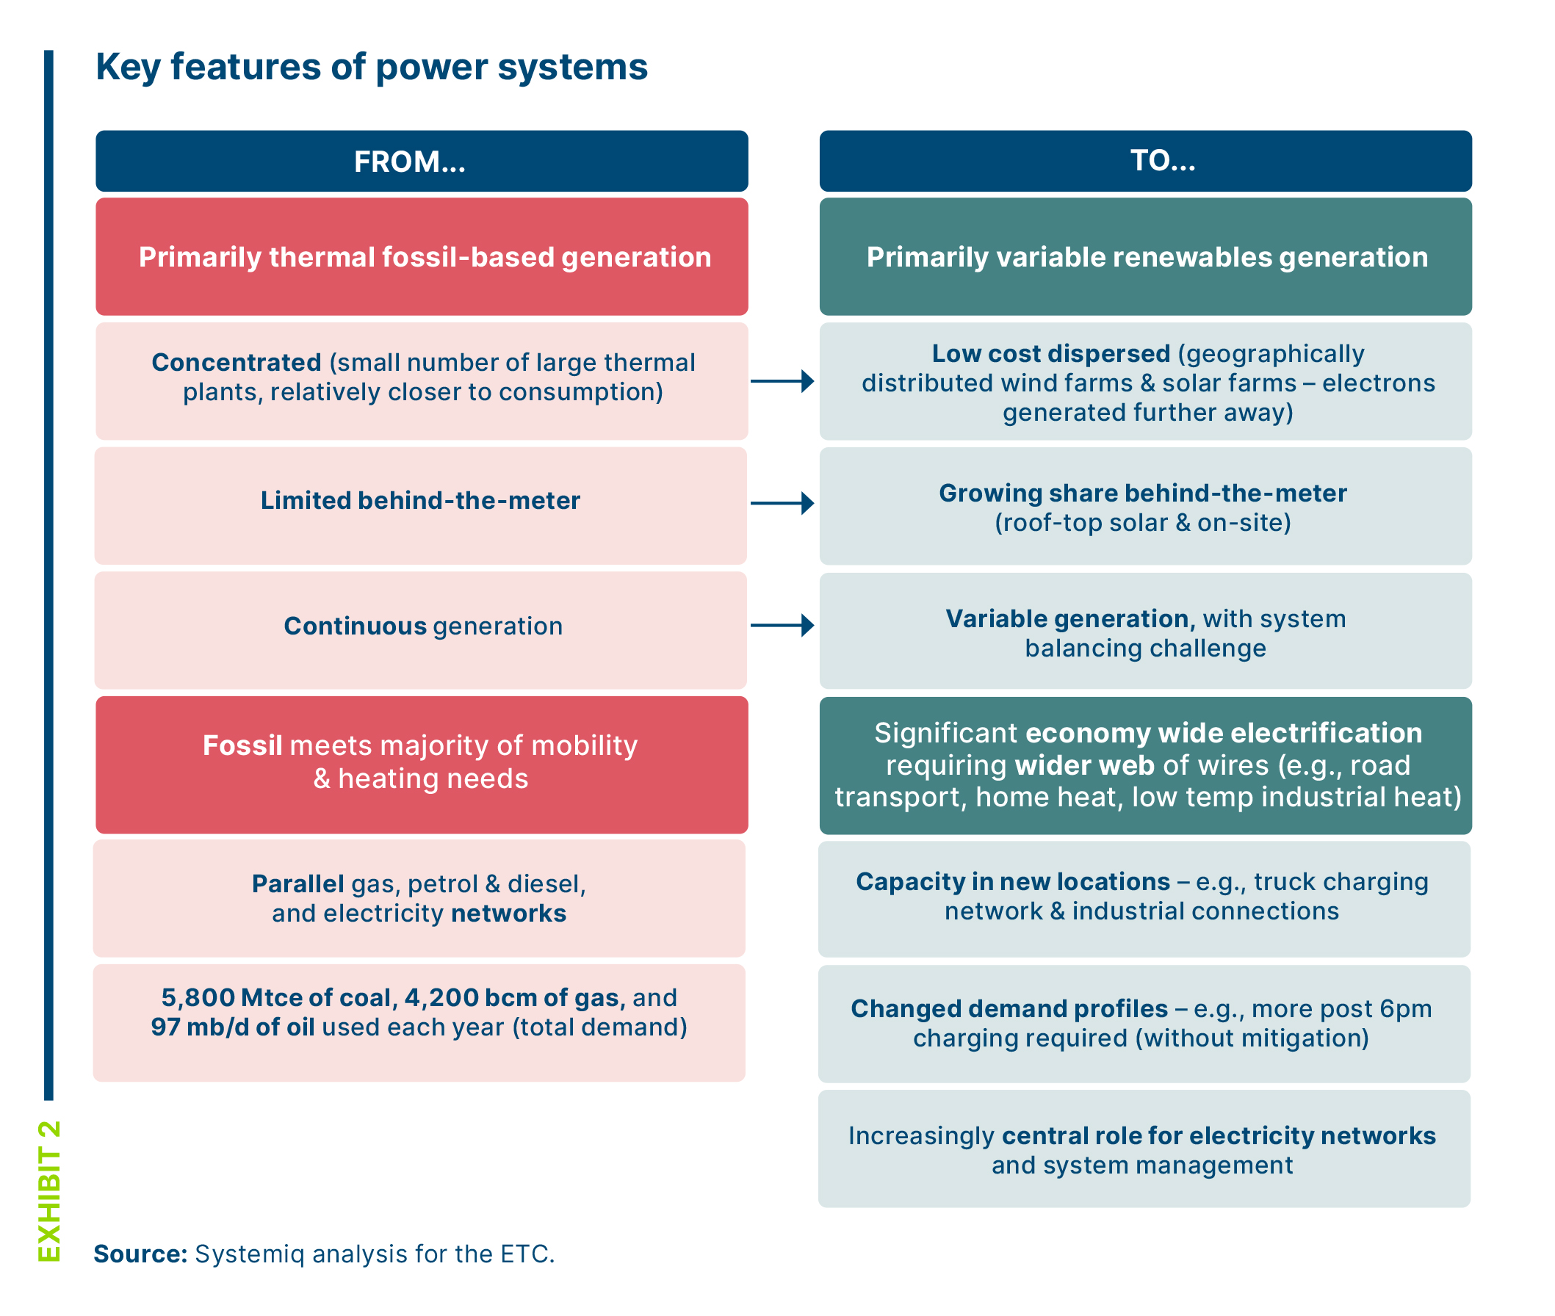
The way that electricity is generated and consumed is changing, moving to a more dispersed system

Slide 4
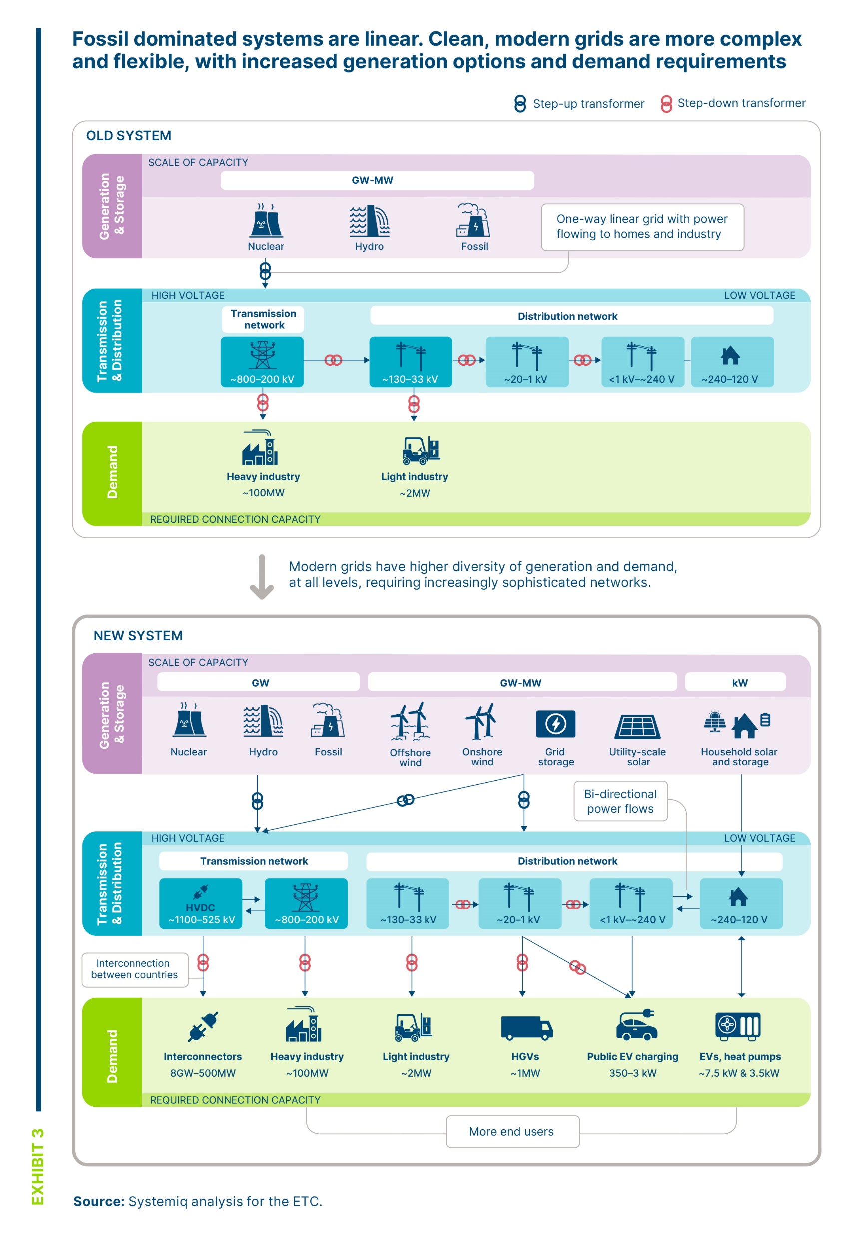
Grids will evolve to become more complex and flexible in a system dominated by clean electrification

Slide 5
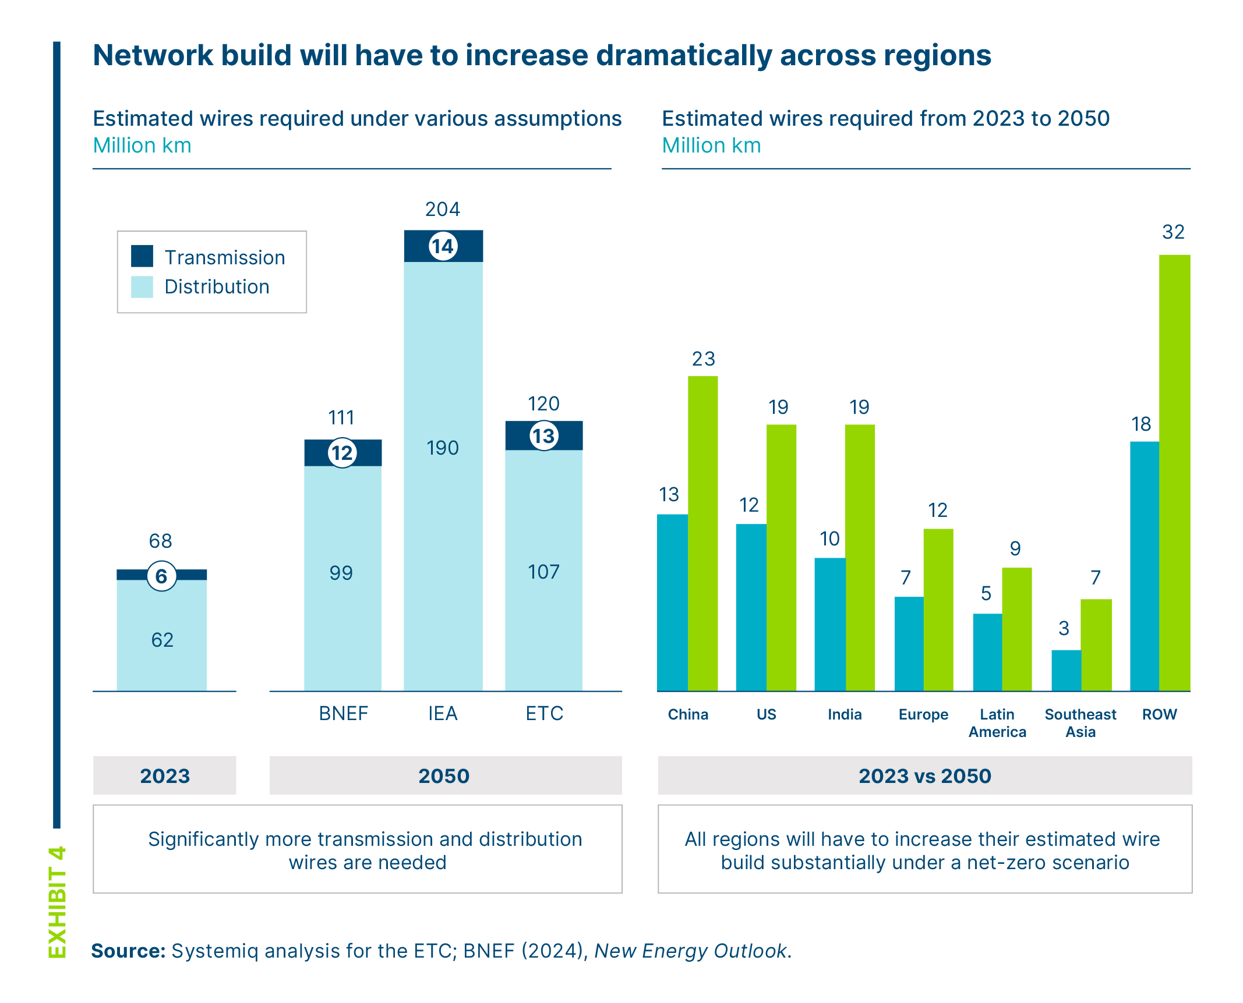
The size of the grid will need to grow by over 50% by 2050 to meet net-zero trajectories

Slide 6
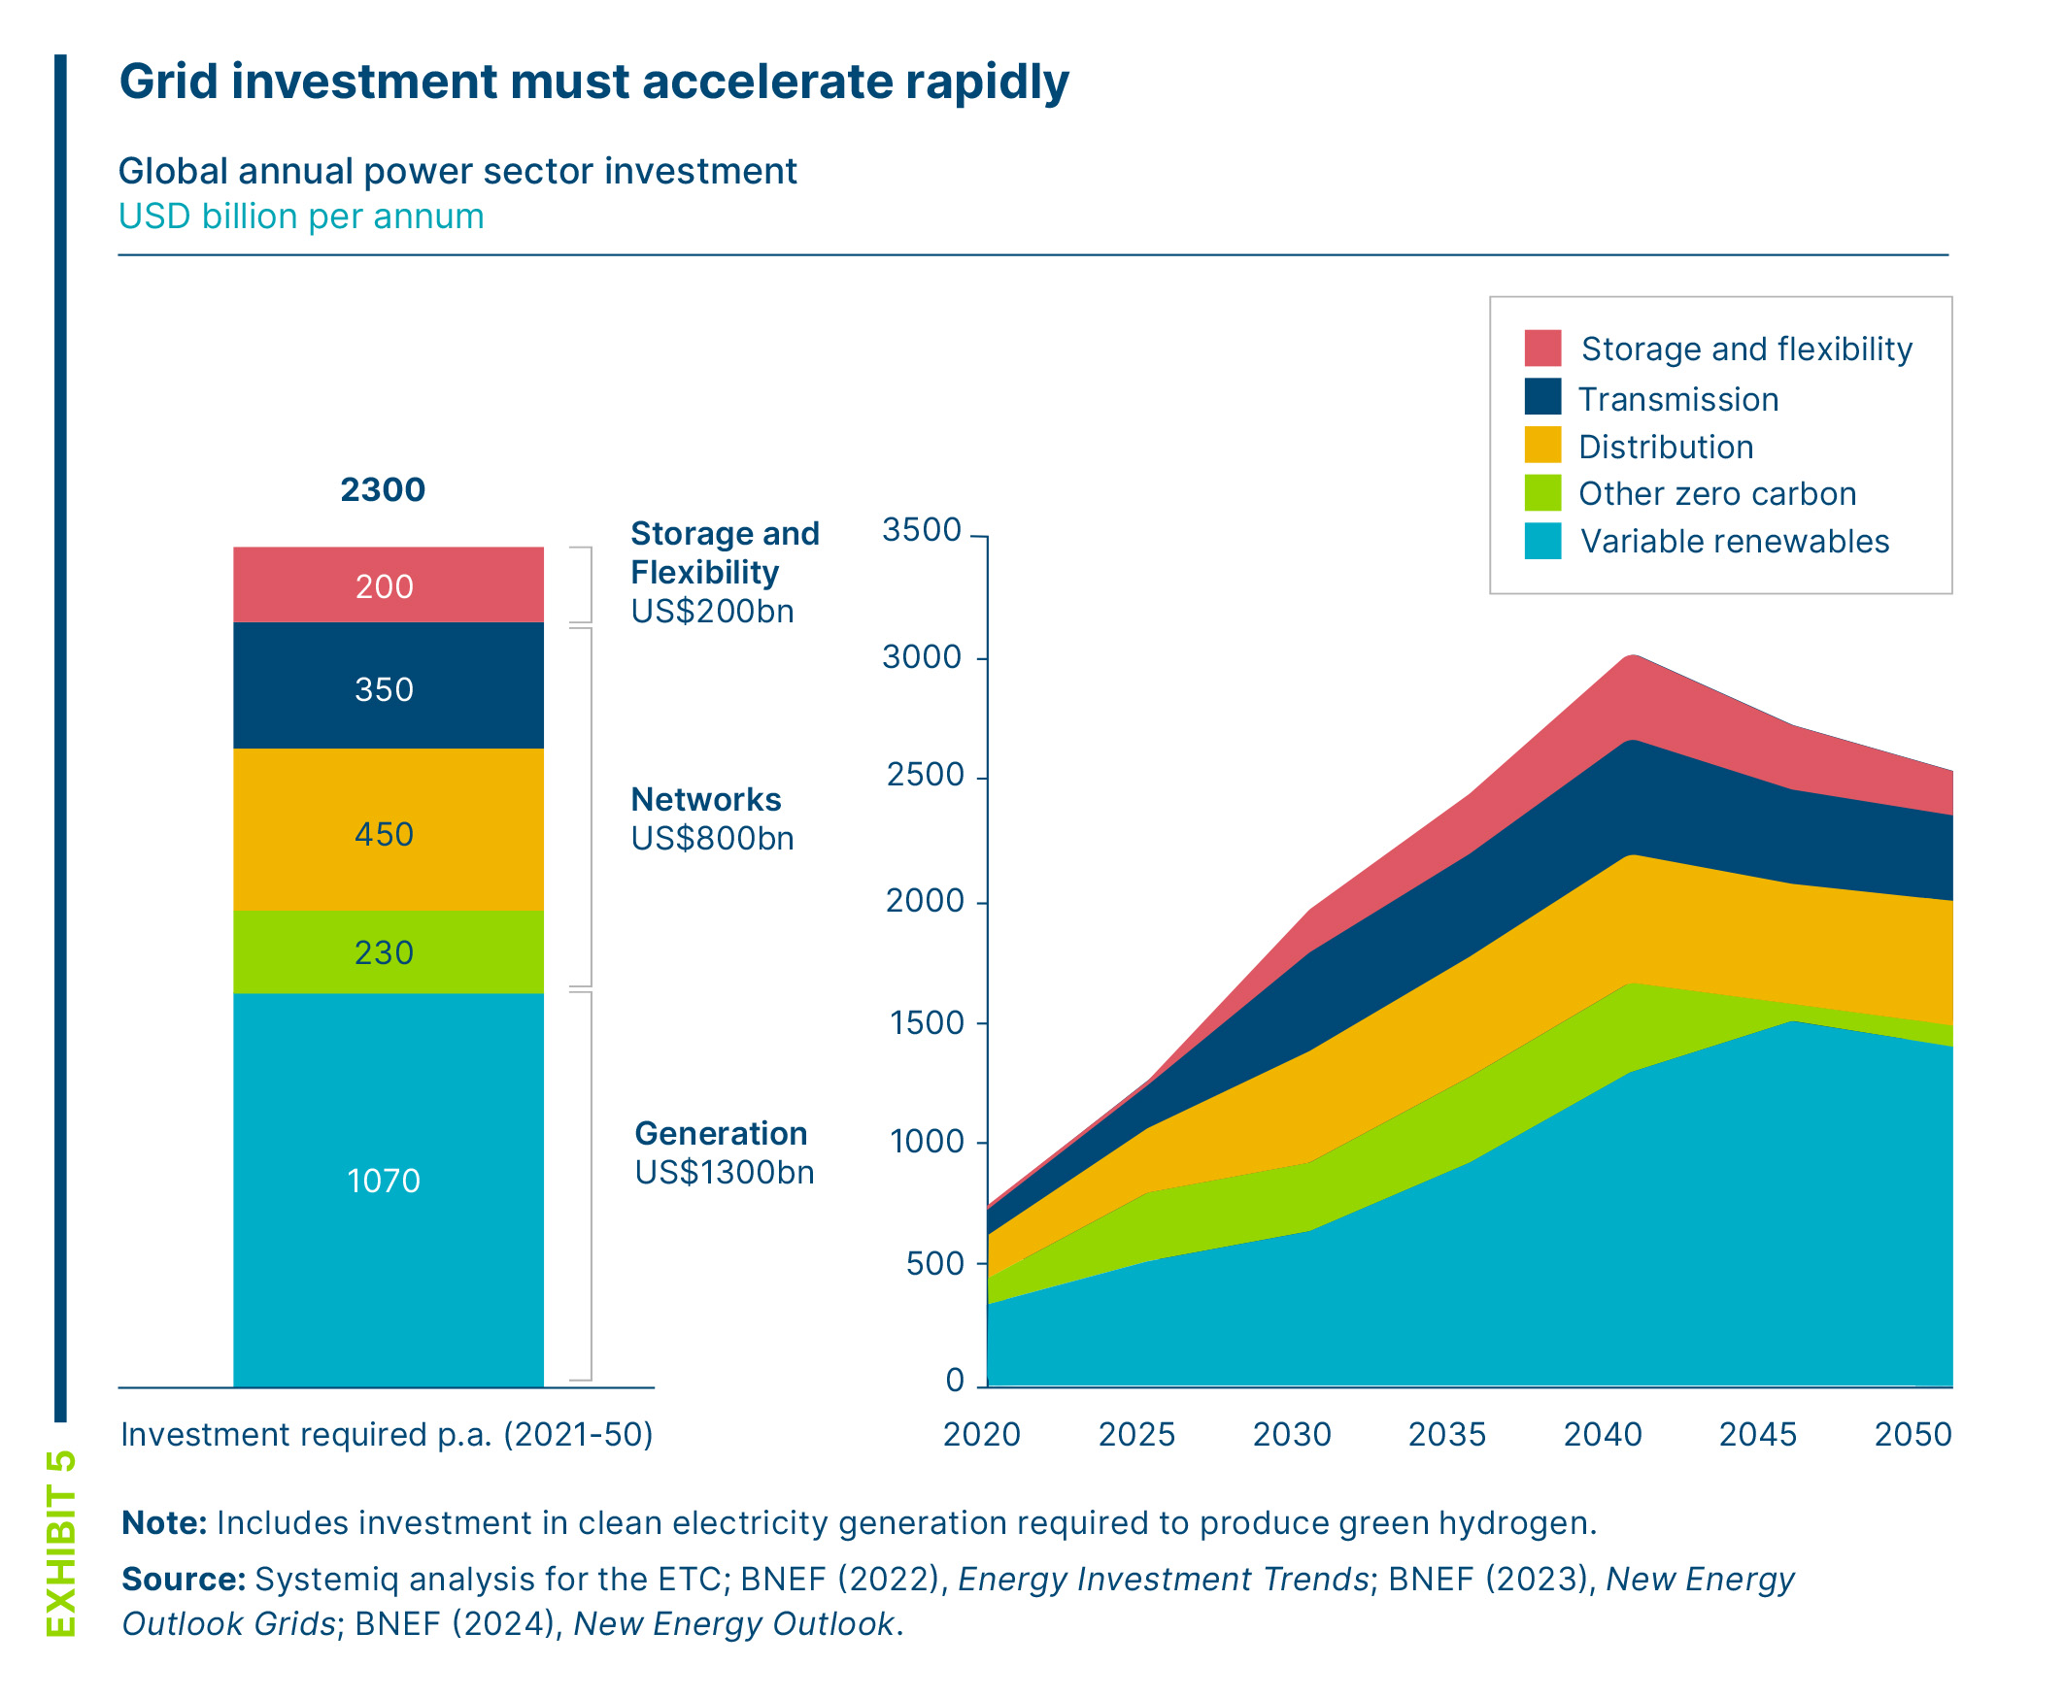
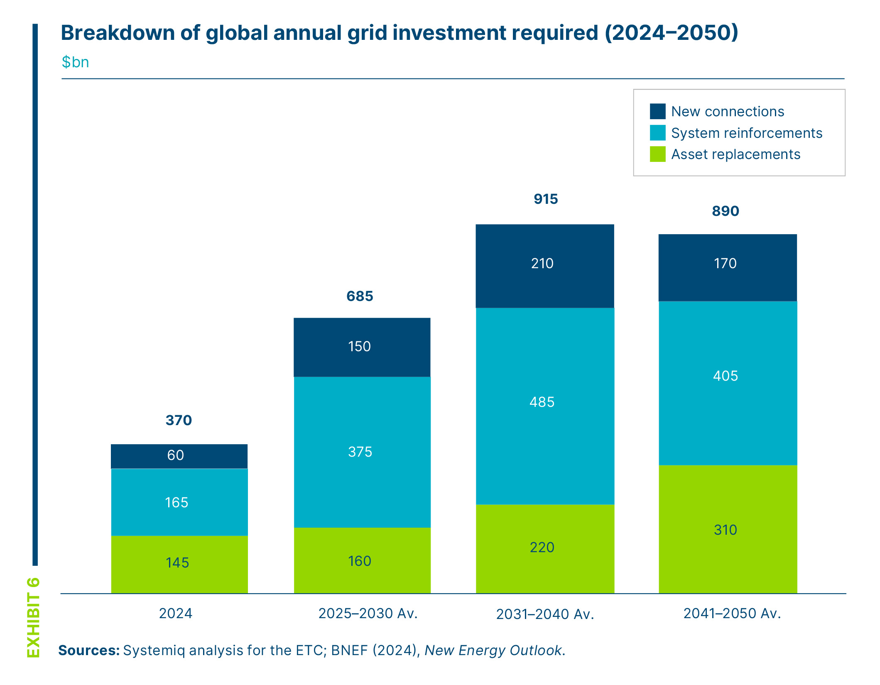
Grid investment needs to rise rapidly from ~$300 billion p.a. today to ~800 billion p.a. in 2050, across new connections, system reinforcements and asset replacements

Slide 7
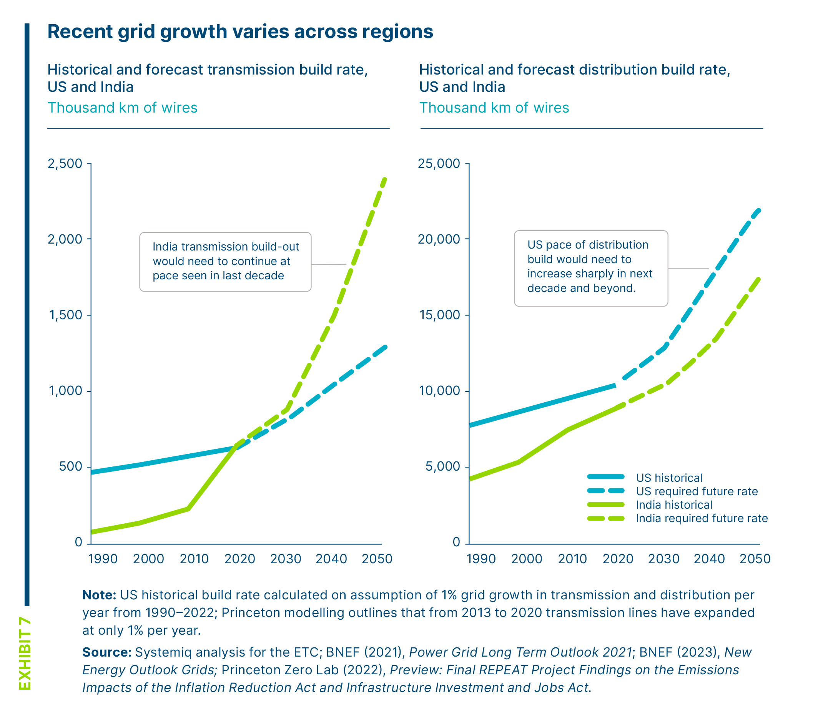
Building grids at the rate required will be a step-change for many countries

Slide 8
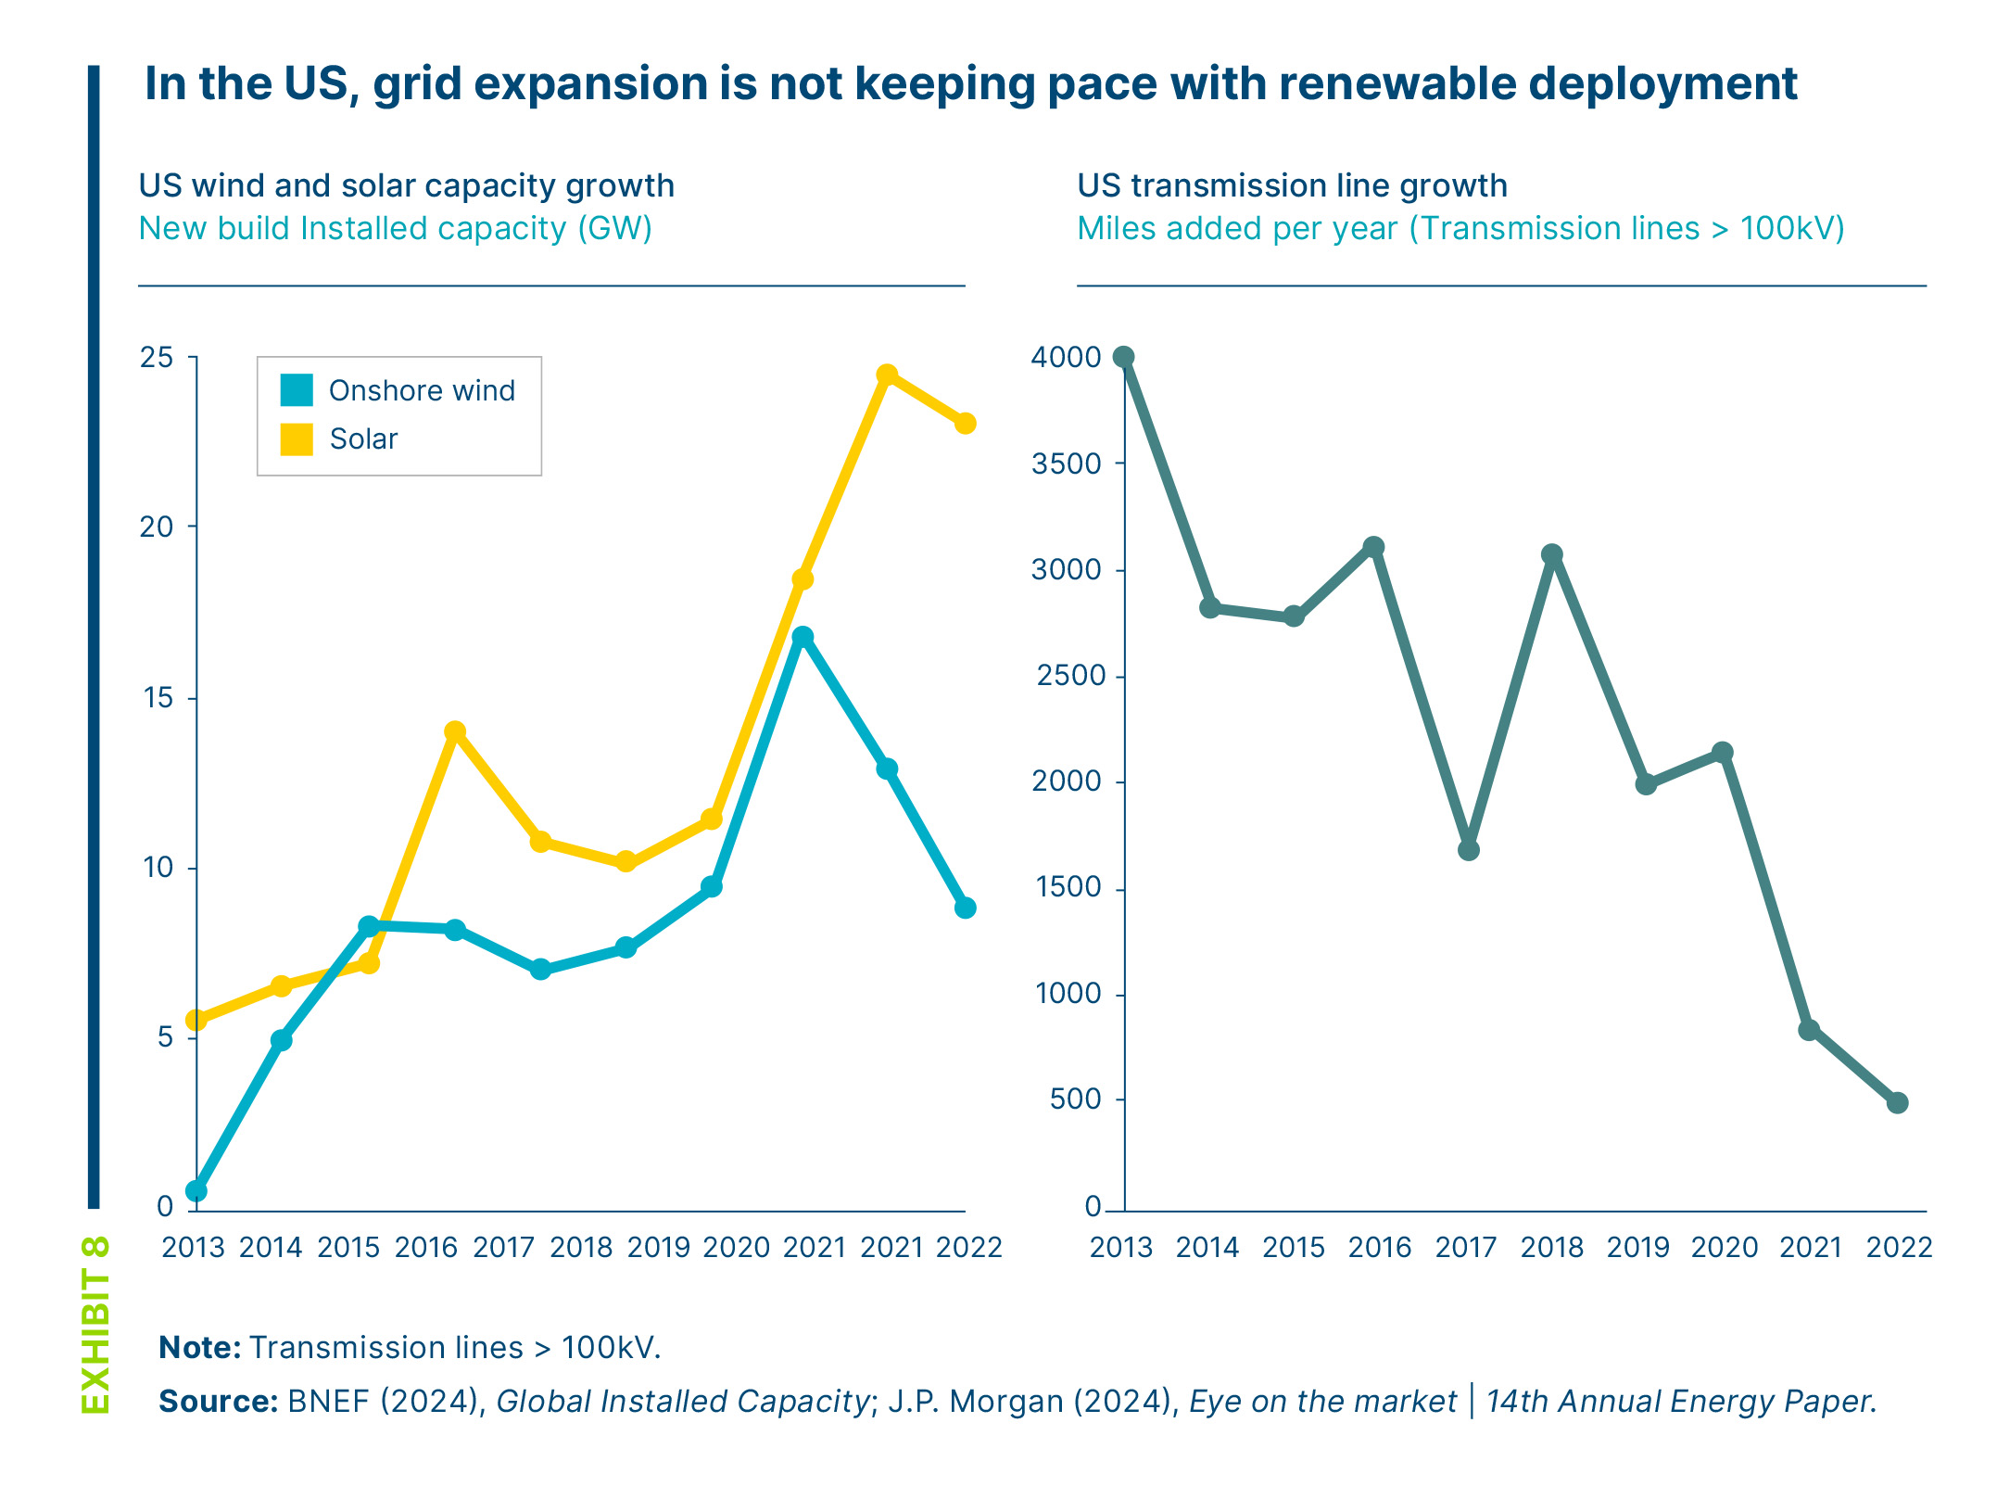
Grid growth has lagged the rapid expansion of renewables

Slide 9
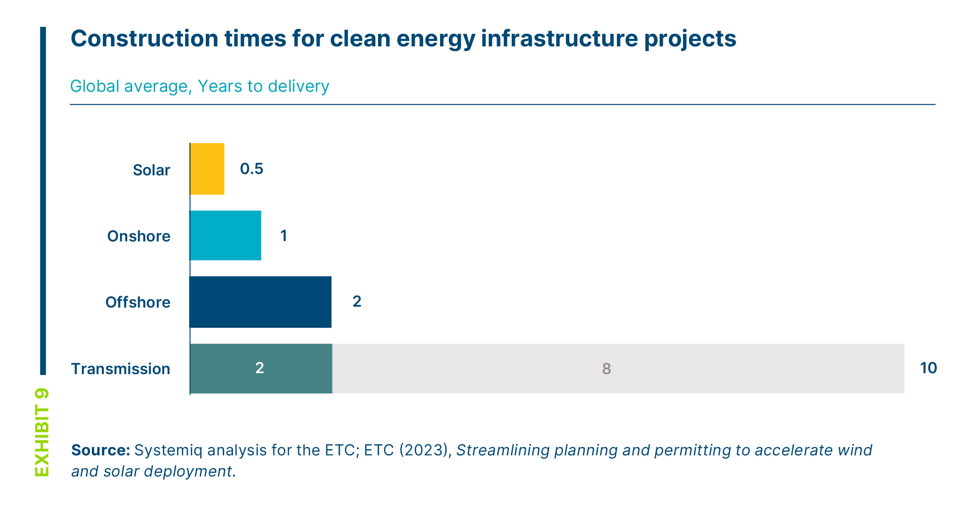
Slow grid planning and approvals can hamper renewable deployment
Notes: Whilst the actual construction times of transmission lines generally only take 1-2 years, planning and permitting issues mean it commonly takes at least 10 years to complete construction. Often more transmission is required for renewable projects to connect to the grid, introducing further backlogs.

Slide 10
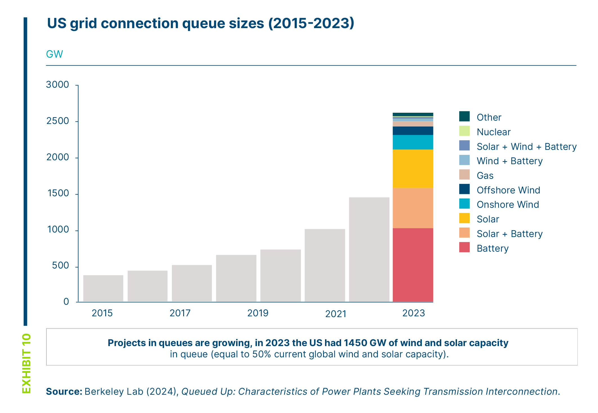
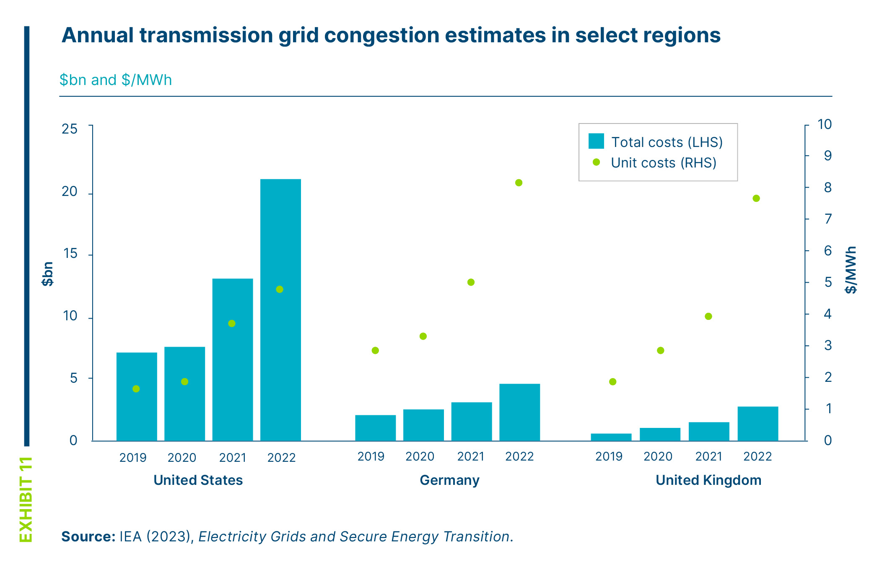
Lack of grid capacity is having significant consequences, including delaying renewable connections and increasing system costs via congestion payments

Slide 11
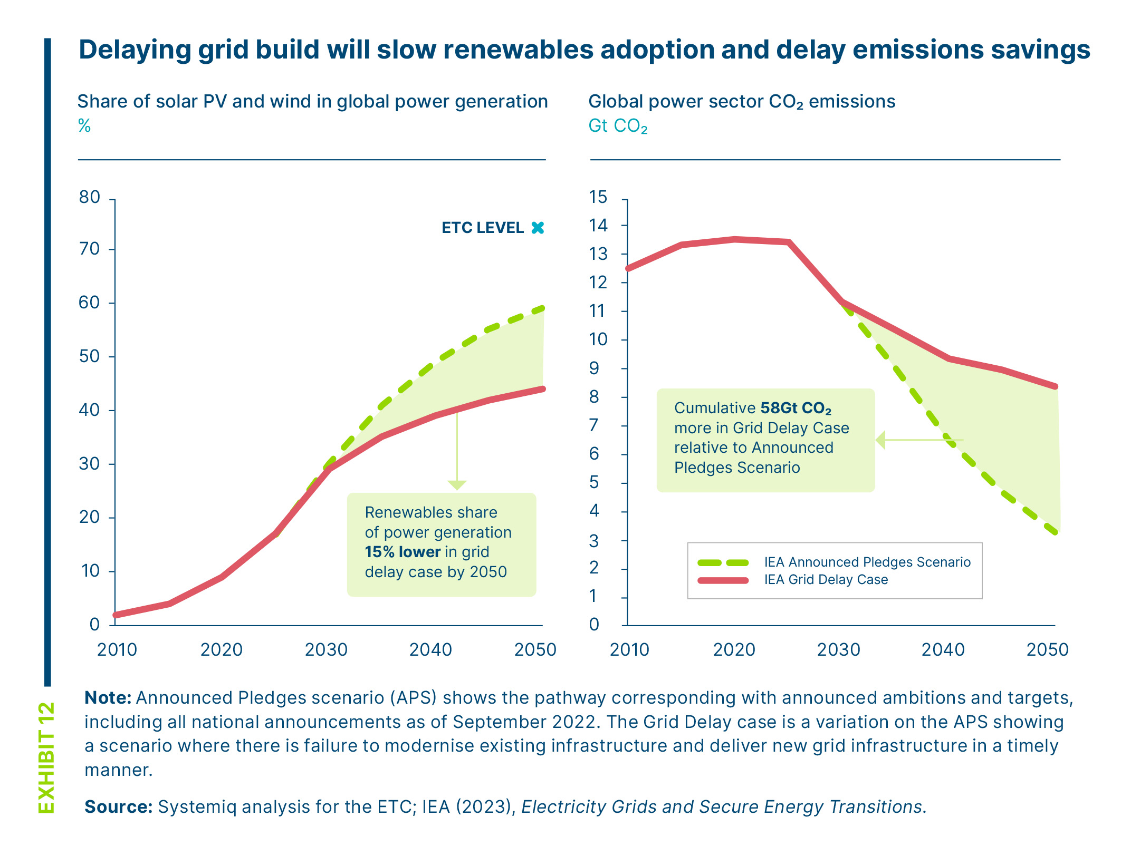
Failing to build grids at speed required will block large volumes of cheap, clean renewables coming online – locking in higher emissions and costs

Slide 12
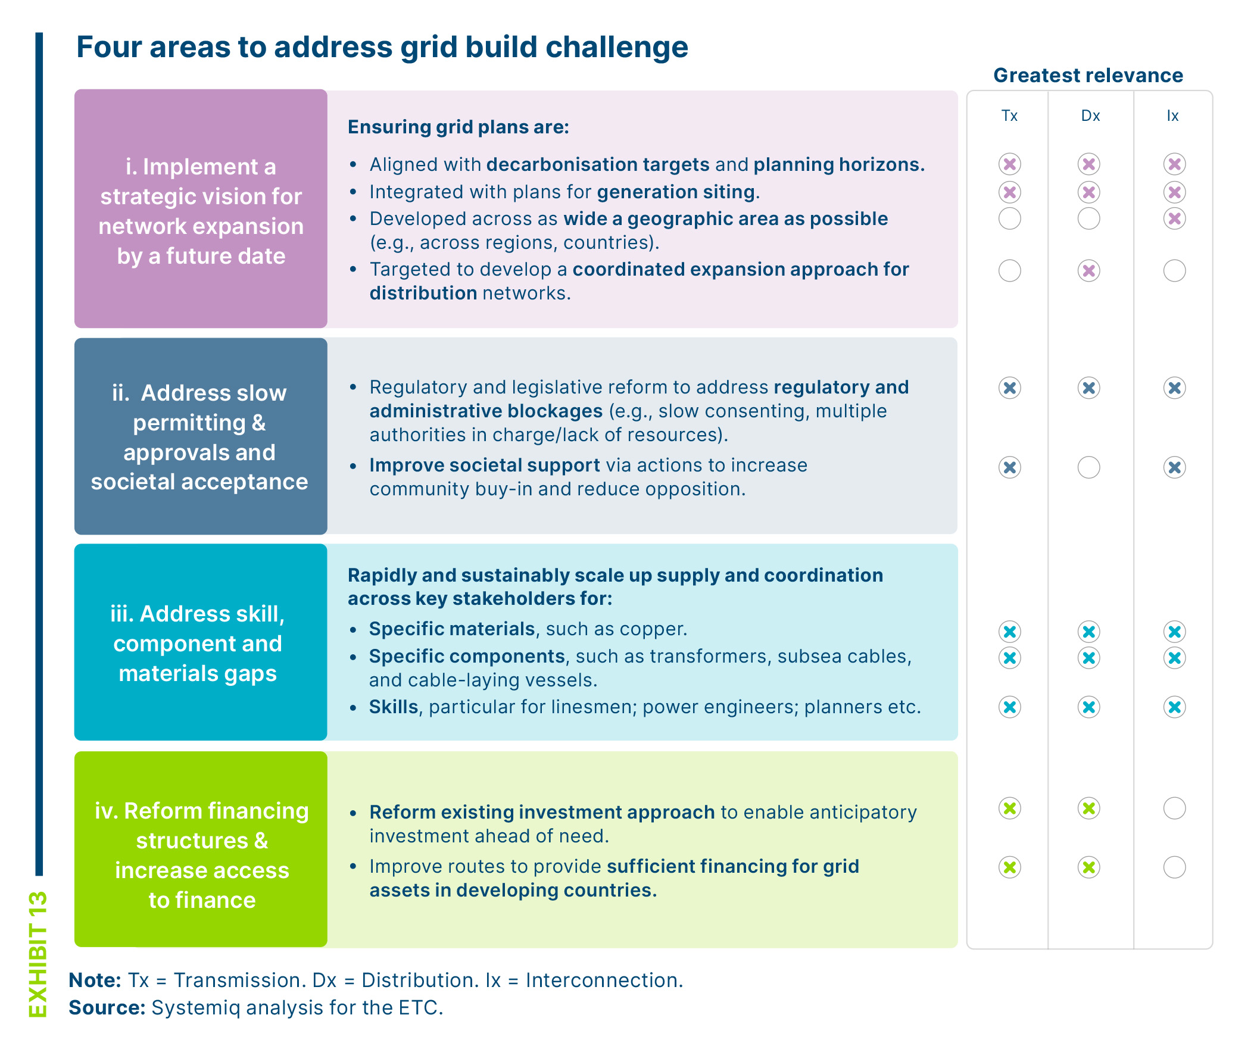
To accelerate the pace and scale of build policymakers and industry must take action across four critical areas.

Slide 13
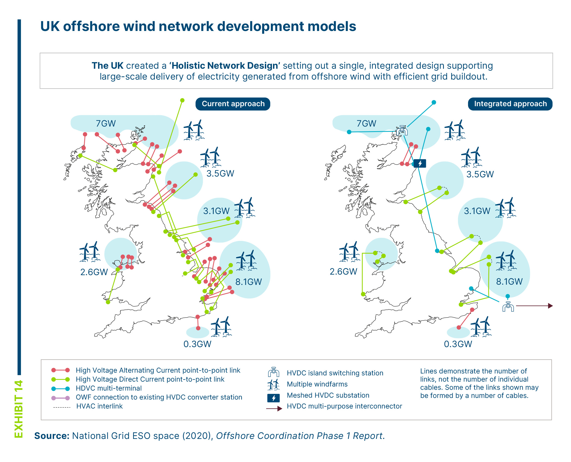
A strategic vision for grids and generation, coordinated across key stakeholders and supported by clear data is needed

Slide 14
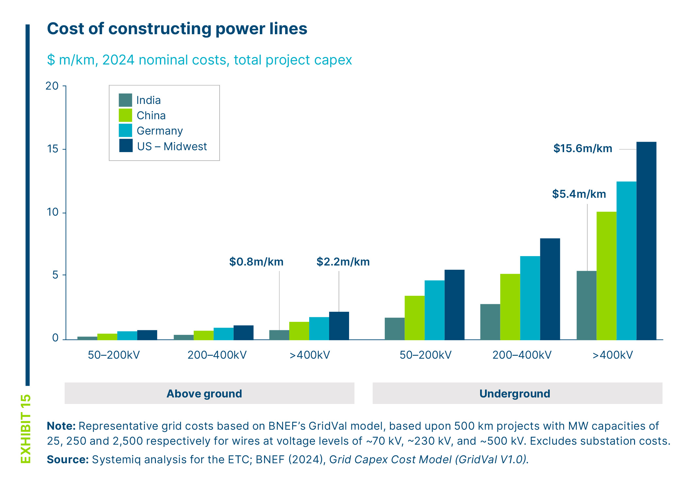
Building wires underground may help address societal support challenge, but comes at a cost 7 times that of above ground wires

Slide 15
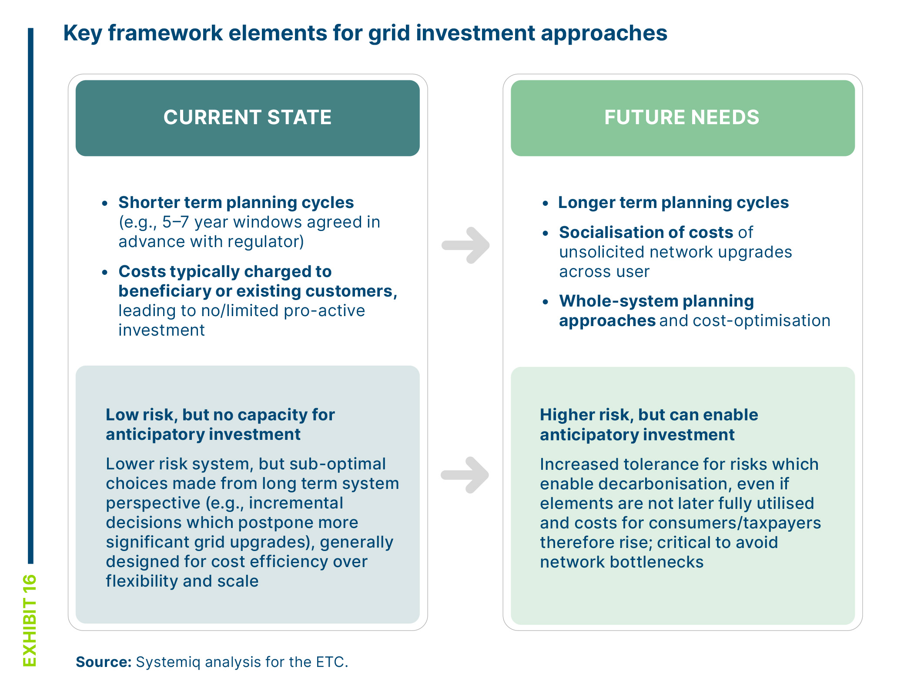
Financing structures should be reformed and routes to access finance improved

