Slide 1
Credible Contributions:
Bolder plans for higher climate ambition in the next round of NDCs
Key messages

Slide 2





















































Energy
Industry
Chair
Adair Turner
Finance
Knowledge partners
Civil society

Slide 3



ETC Impact Model
Fact based, collaborative, action-oriented research approach
Findings are industry-backed and owned
Extensive engagement
with critical decision makers to disseminate findings
ETC members own conclusions and advocate for recommendations externally
Policymakers are more receptive to recommendations backed by business leaders
Transforming members’ outlook and knowledge is leading to new strategies

Slide 4
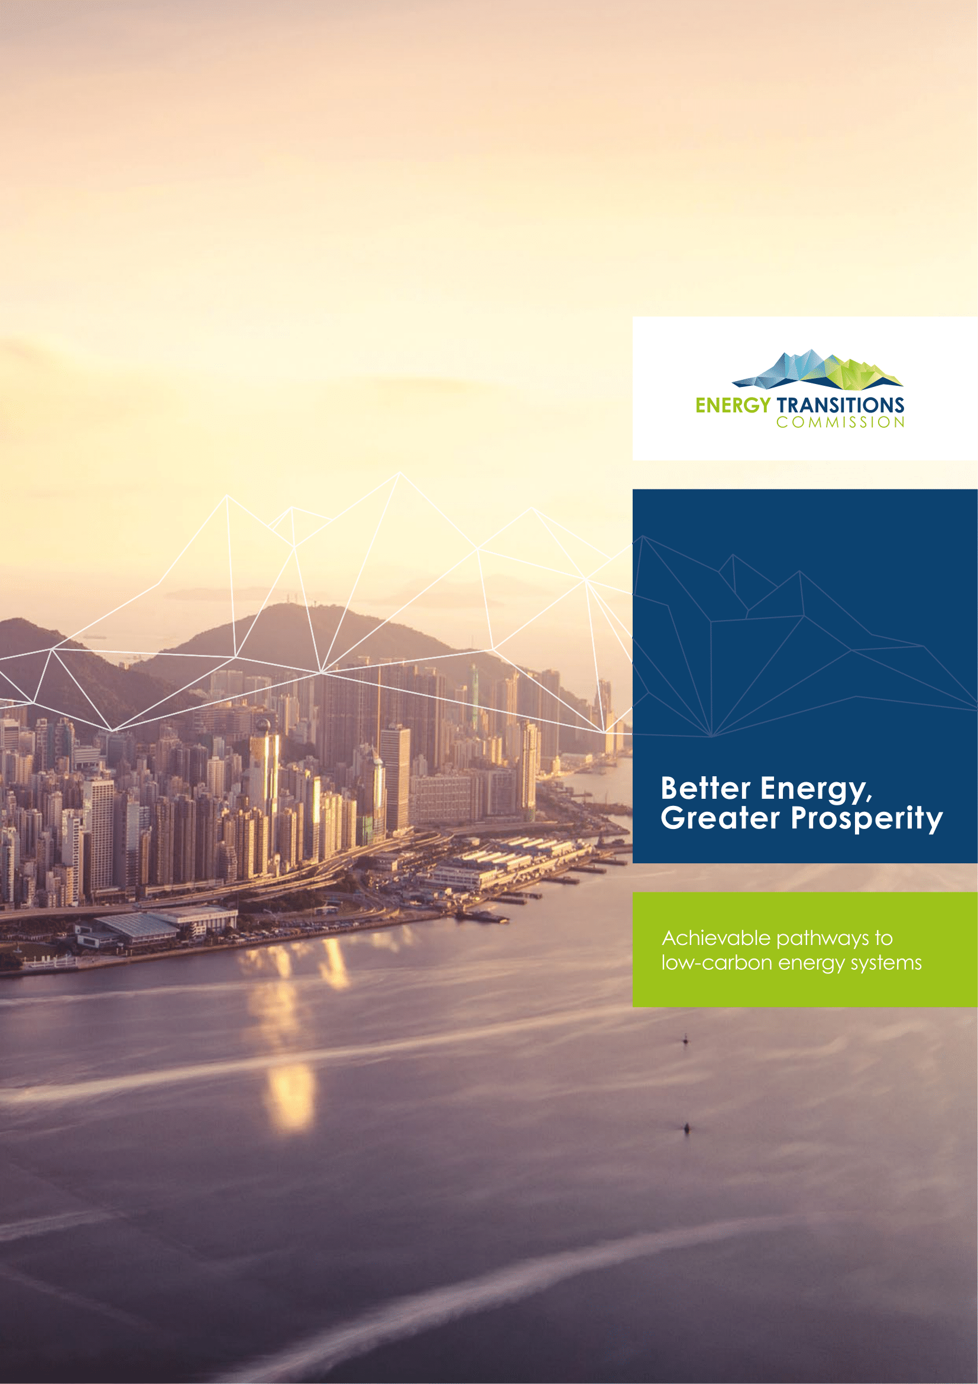
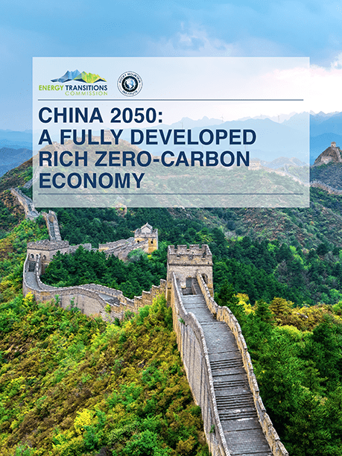



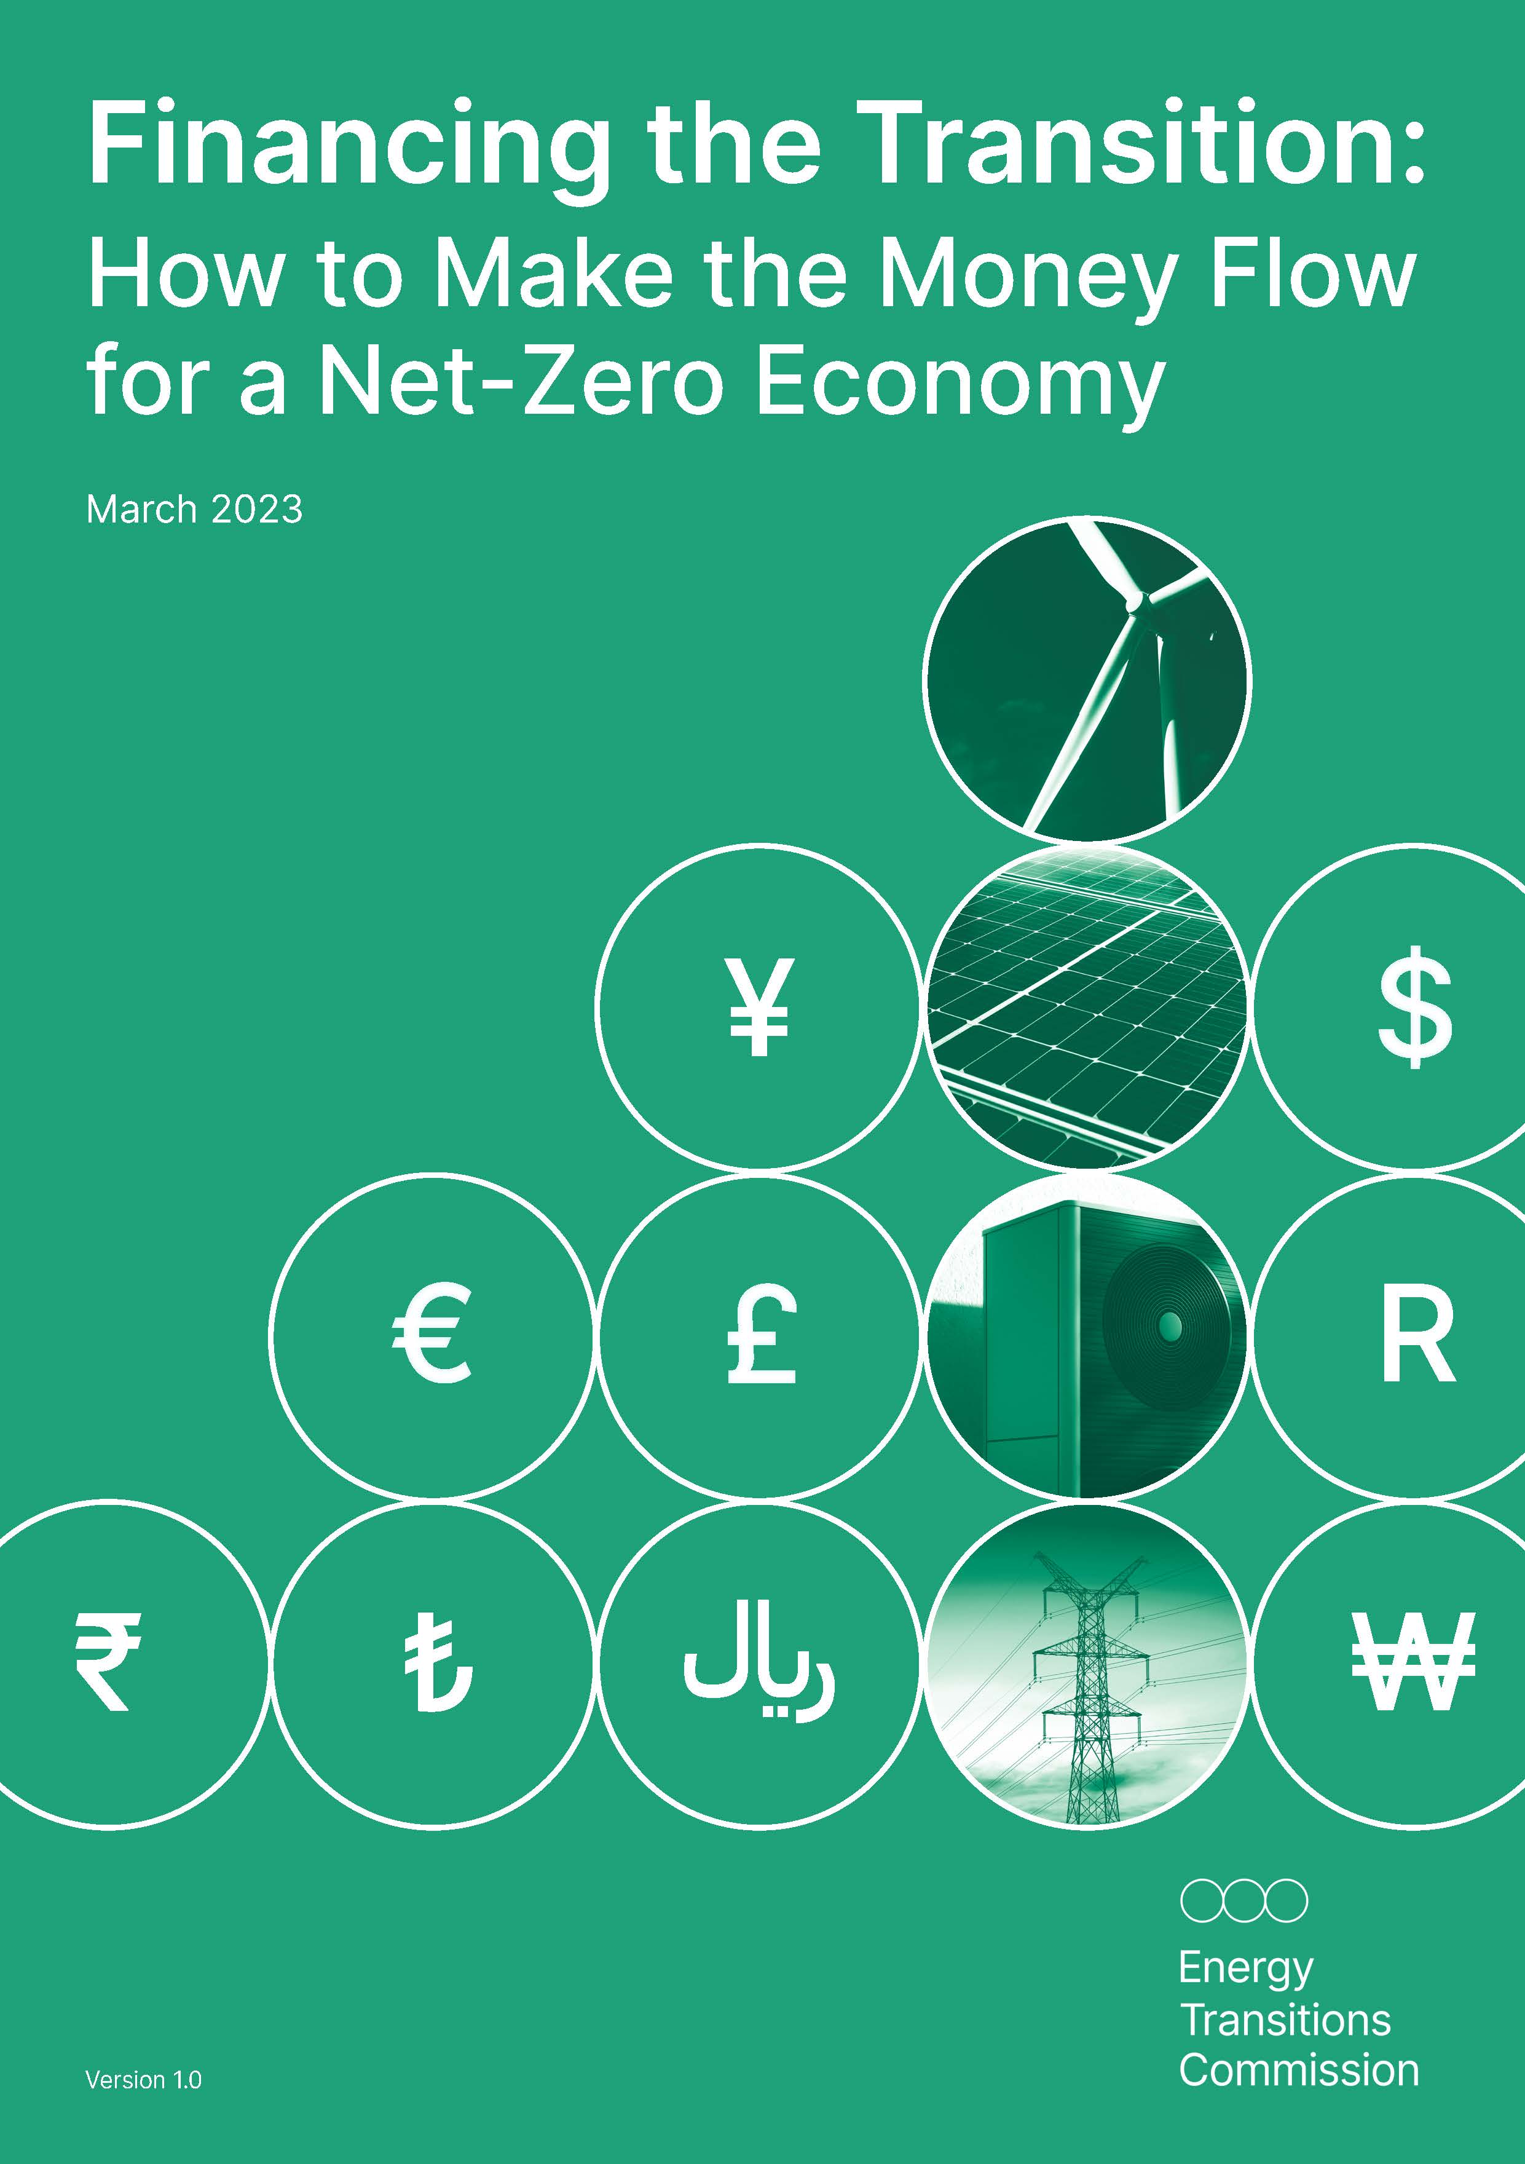

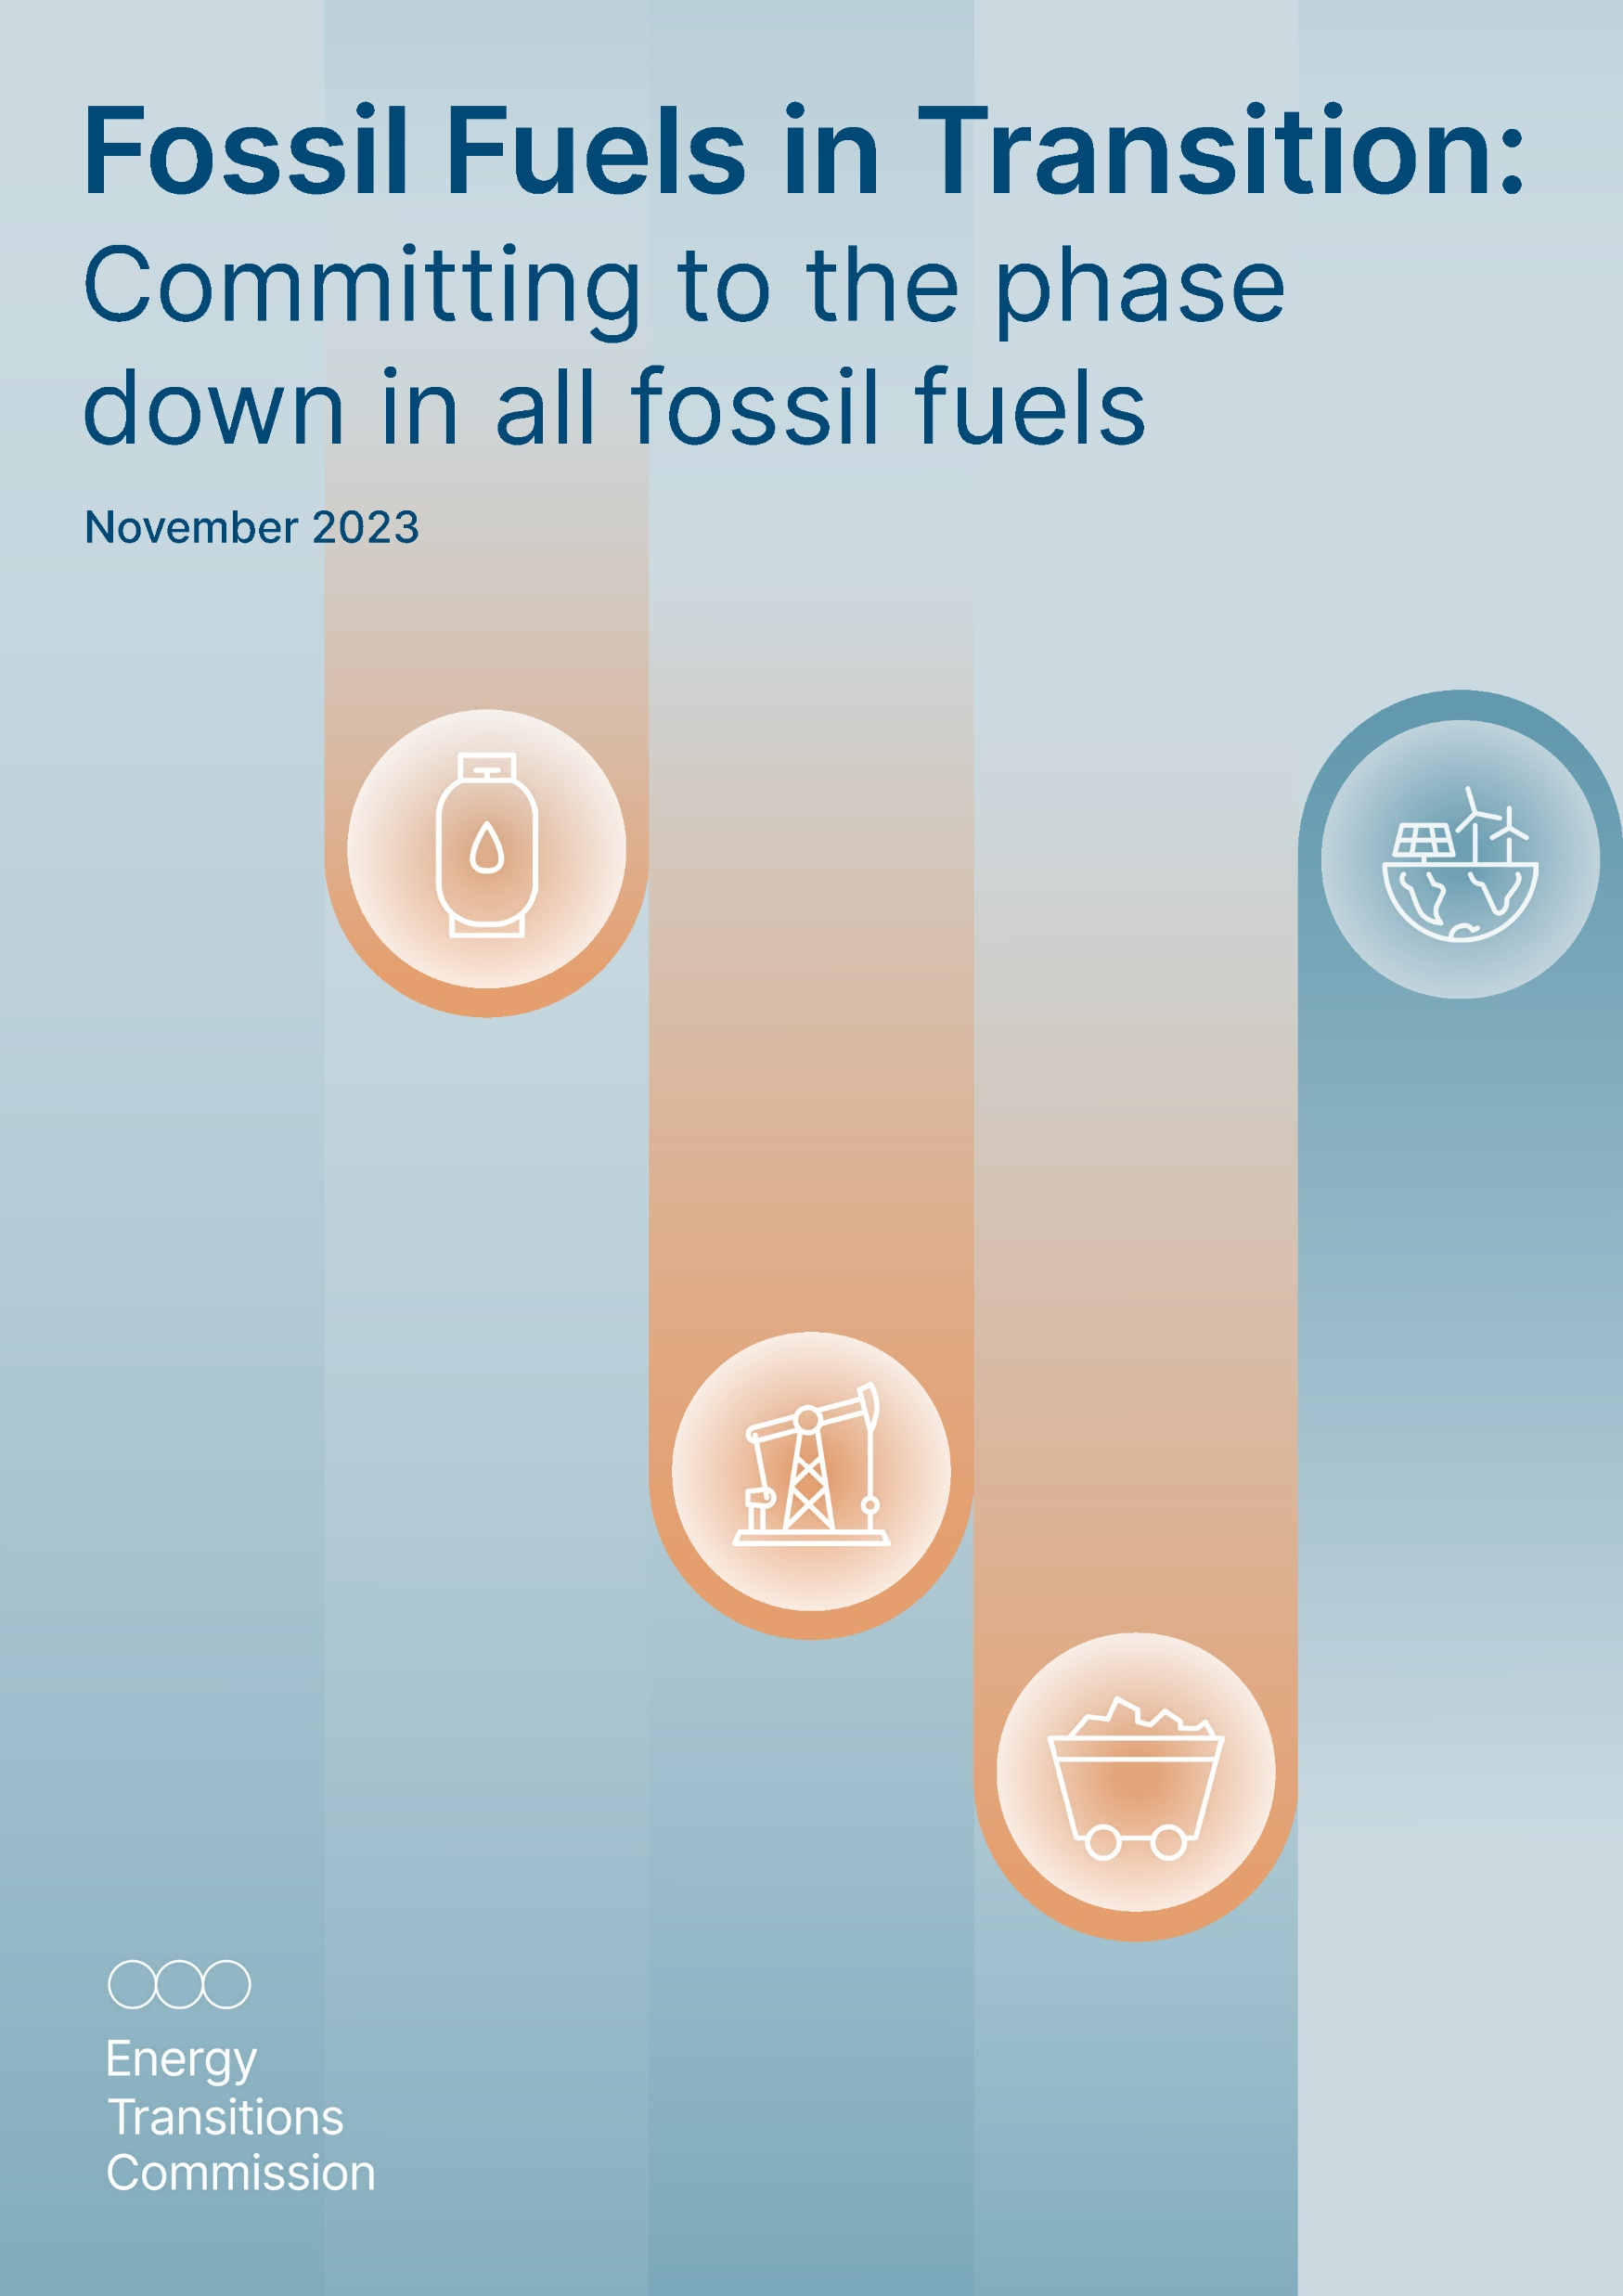



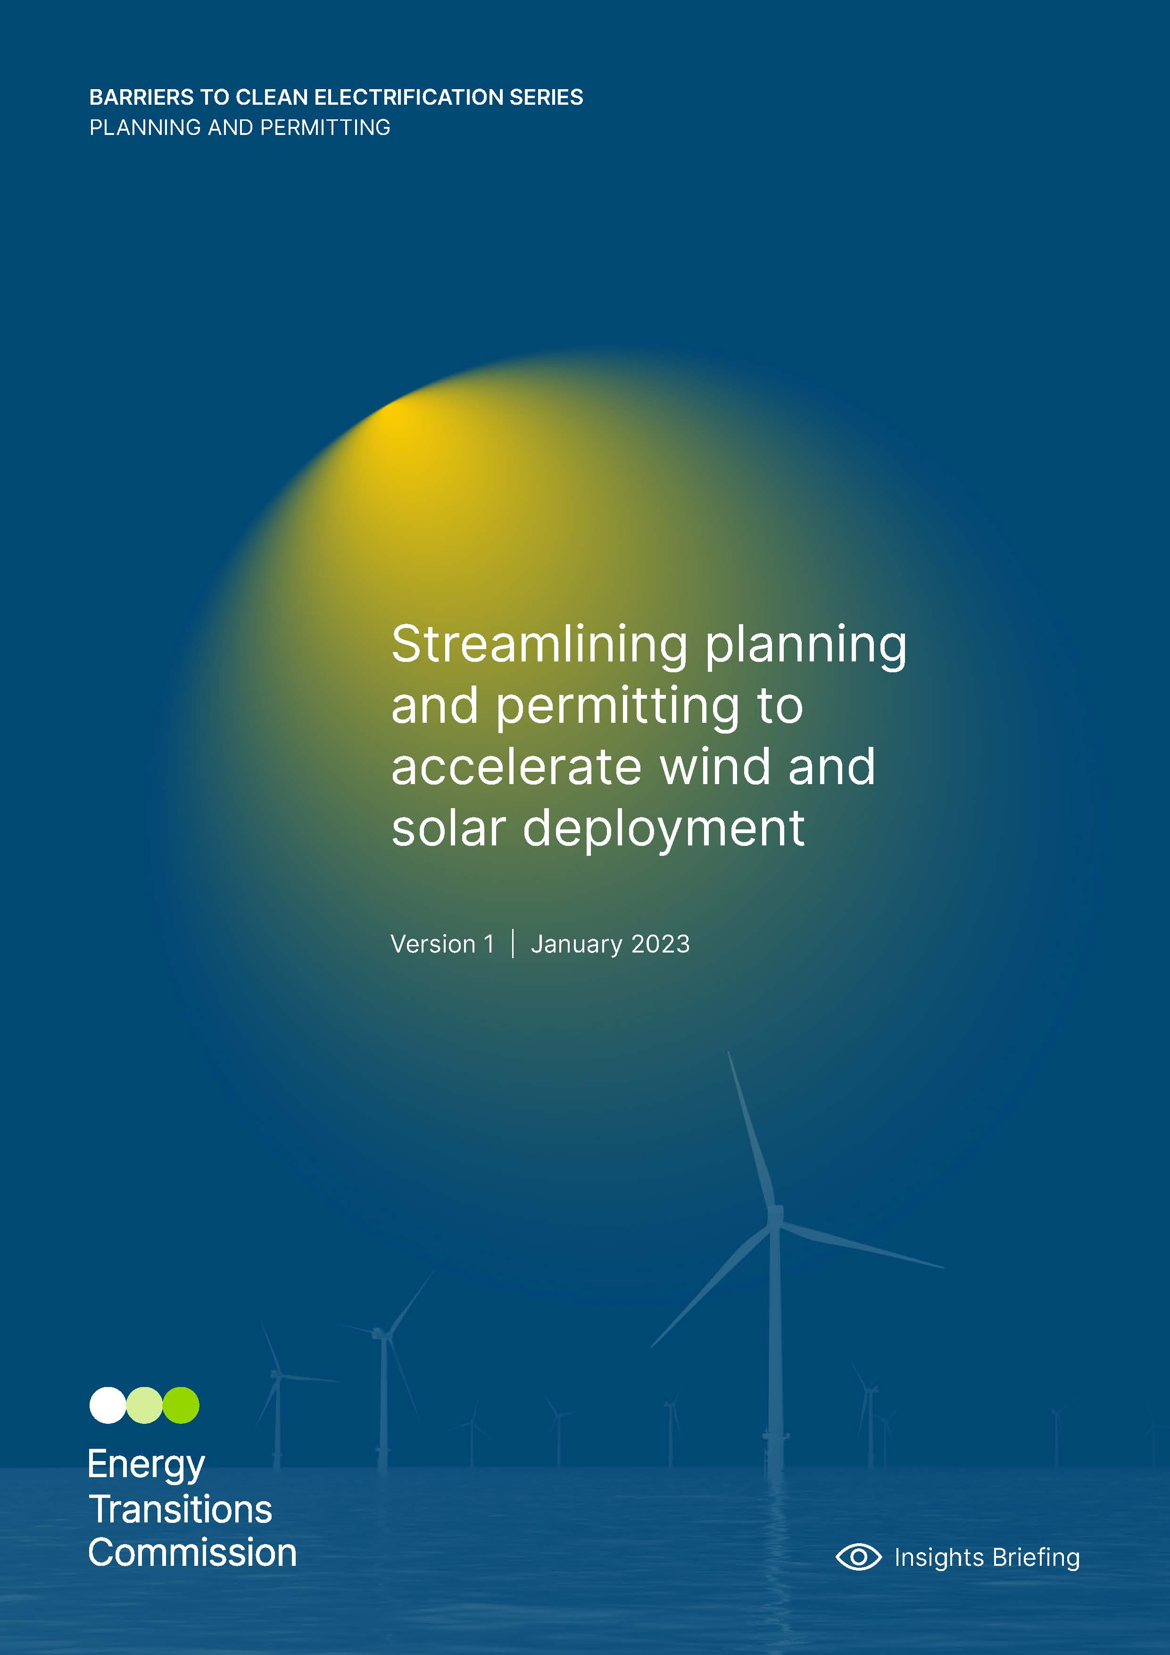
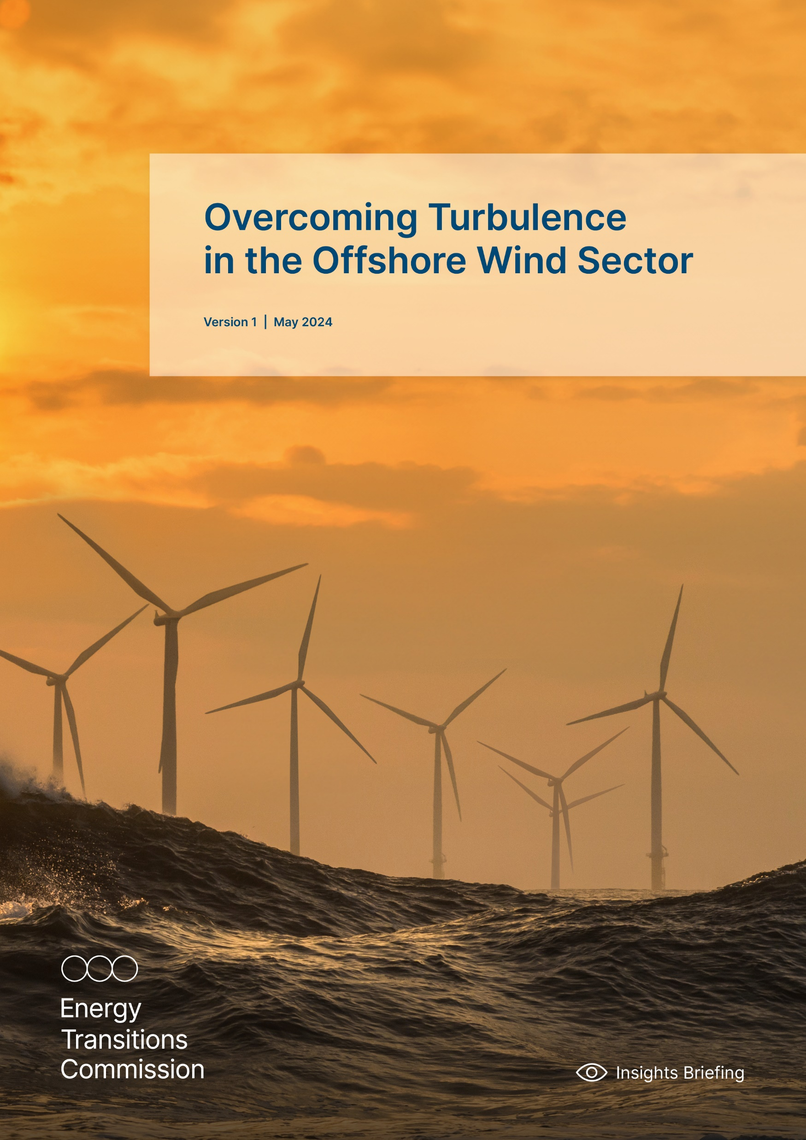




ETC Publications – Timeline 2017-2024
2017
2018
2019
2020
2021
2022
2023
2024

Slide 5
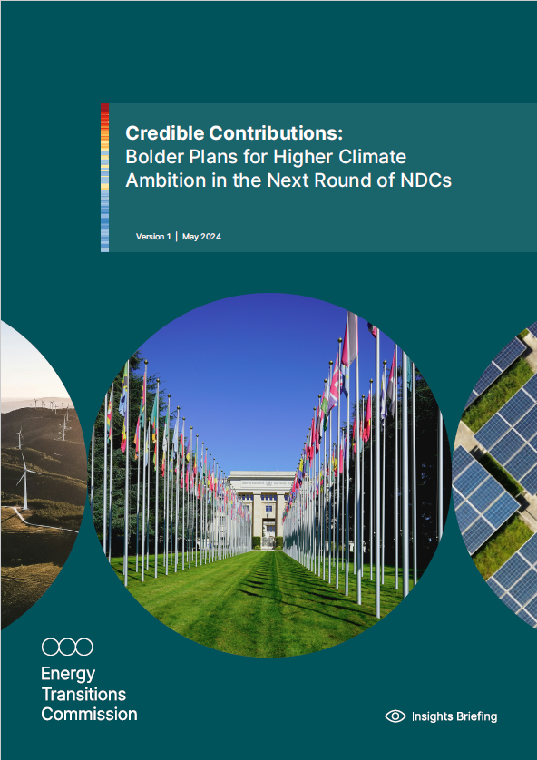
Insights Briefing Key Messages
The ETC calls for industry and government collaboration to raise the ambition of the next round of NDCs due by COP30.
Ambition in upcoming NDCs (“NDCs 3.0”) can triple.
NDCs 3.0 must help translate ambition into action - more ambitious NDCs, and stronger links between targets and policies, are critical to drive investment and climate action.
Ambition alone will not achieve rapid progress – NDCs must also clearly set out how targets will be achieved.

Slide 6
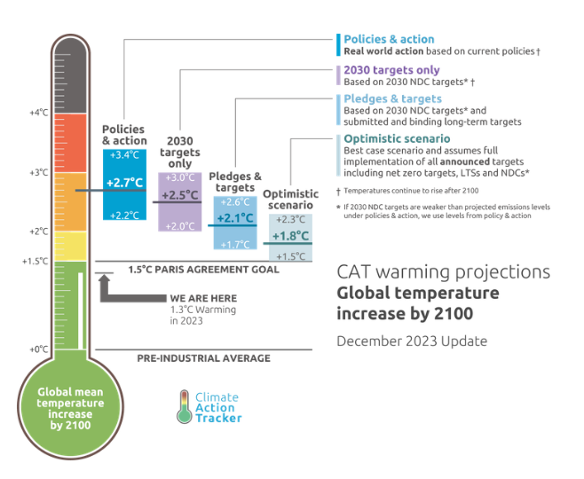
NDCs are countries’ pledges to reduce national GHG emissions – today, targets in NDCs, if delivered, are only expected to limit global warming by +2.5°C
WHAT ARE NATIONAL DETERMINED CONTRIBUTIONS (NDCs)?
Nationally Determined Contributions (NDCs) are countries’ pledges to reduce national emissions and adapt to impacts of climate change.
Countries are required to submit their NDC and increase their ambition every 5 years to reflect progress.
The next round of NDCs (”NDCs 3.0”) must be submitted by COP30 in 2025, setting targets and outlining plans to 2035.

Slide 7
Countries must submit new NDCs by COP30 in Brazil in 2025 – current policies are only expected to limit global warming to +2.7°C
NDC Process
Evolution of global GHG emissions (left) and 2100 global temperature increase (right)
In GtCO₂e (left) and °C relative to pre-industrial averages (right)
Policies and actions
Global Stocktake
Global GHG emissions
Key 5-yearly NDC
Ratchet COPs
COPs
From INDCs
to NDCs
Bringing the Paris Agreement to life: further detail outlined in NDCs
1st round of NDC updates: long-term success, short-term failure
Global Stocktake, 2nd round of NDC updates: last chance to close the gap to 1.5°C
2021
COP26
Glasgow Climate Pact
2024-25
2nd NDC update (“NDCs 3.0”)
2015
COP21
Paris
2018
COP24
Katowice Climate Package
2022
COP27
Sharm el-Sheikh Implementation Plan
2025
COP30
Brazil
2016
1st NDC
Publication (“NDCs 1.0”)
2020
1st NDC update (“NDCs 2.0”)
2023
COP28
Dubai
UAE Consensus + Outcome of 1st Global Stock Take
2014
2015
2016
2017
2018
2019
2020
2021
2022
2023
2024e
2025e
Note: INDCs = Intended Nationally Determined Contributions, emissions and temperature outcomes post-2023 are assumed constant for illustration purposes.
Source: Systemiq analysis for the ETC, Climate Action Tracker (2023), Warming Projections Global Update December 2023.

Slide 8
Targets of current NDCs, if fully implemented, are only expected to deliver ~6 GtCO₂e of mitigation per year by 2035
Global GHG emissions
GtCO₂e p.a.
Historical¹
NDCs – 2030 Unconditional targets²
2°C Pathway^{2,i,iii}
Current policies²
NDCs – 2030 Unconditional & conditional targets²
1.5°C Pathway^{2,ii,iii}
60
55
~6 GtCO₂e
Implementation gap
50
45
11–19 GtCO₂e
Ambition gap to 2°C
40
35
23–30 GtCO₂e
Ambition gap to 1.5°C*
30
25
*Note: not all countries have adopted 1.5°C as their official target
0
Notes: [i] Based on IPCC Working Group III Sixth Assessment Report scenario class c1 (limit warming to 1.5°C (>50%) with no or limited overshoot). [ii] Based on IPCC Working Group III Sixth Assessment Report scenario class c3 (limit warming to 2°C (>67%)). [iii] Range corresponds to range between tenth and ninetieth percentile, central line corresponds to median.
Sources: Systemiq analysis for the ETC based on [1] IPCC (2022), Metadata Browser: Data for Figure SPM.5 - Summary for Policymakers of the WGIII Contribution to the IPCC AR6, [2] UNEP (2023), Emissions Gap Report: Broken Record.

Slide 9




The world needs much more ambitious NDCs 3.0 – a real economy ambition loop means raising ambition will increase deployment. Increased deployment also raises ambition.
More ambitious NDCs underpinned by clear sectoral targets and policies
Increased government confidence on ability to deliver on higher climate ambition with support from industry
CLIMATE
AMBITION
Reduced optionality and increased market certainty for industry to invest and deploy low-carbon technologies

Slide 10







Governments can significantly raise the ambition in their new NDCs
More ambitious NDCs underpinned by clear sectoral targets and policies
Rapid technology progress, reducing costs and increasing deployment
Industry commitments to scale up and decarbonise
National commitments already made (e.g. at COP28)

Slide 11
The cost of key technologies for the energy transition has fallen significantly over the past decade …
LCOE global benchmarks
$/MWh (2022 real)
 | Current LCOE ($/MWh) | % change between 2014 - 2023
 | 40 | -80%
 | 40 | -60%
 | 80 | -70%
 | 135 | -80%
Solar PV
Onshore wind
Offshore wind
Battery
Fossil-based LCOE range (coal & gas)
2010
2011
2012
2013
2014
2015
2016
2017
2018
2019
2020
2021
2022
2023
Note: the LCOE is the long-term breakeven price a power project needs to recoup all costs and meet the required rate of return. The global benchmarks are capacity-weighted averages using the latest country estimates. Solar PV refers to fixed-axis. Offshore wind includes offshore transmission costs. Battery is a 4h utility-scale battery and considers delivered power cost. Coal- and gas-fired power include carbon pricing where policies are already active. LCOEs do not include subsidies or tax credits. LCOE does not include transport, storage and distribution costs. Table values have been rounded to the nearest ten.
Source: BNEF (2023), Levelized Cost of Electricity 2H 2023

Slide 12
… resulting in their rapid deployment - these technologies have now likely reached tipping points in most parts of the world, making their accelerated deployment inevitable
Annual deployment of clean energy technologies
Solar and wind: global annual capacity installations; electric vehicles: global annual sales
X
Average deployment for 2030-2035 in IEA Net Zero Scenario
Solar PV
Wind
Electric Vehicles
GW
GW
Millions
Historical
980
Historical
Historical
85
Forecast
865
Forecast
Forecast
840
475
315
120
2010
2015
2020
2025
2030
2035
2010
2015
2020
2025
2030
2035
2010
2015
2020
2025
2030
2035
Note: Data for electric vehicles includes both battery electric and plug-in hybrid passenger vehicles. Values are rounded.
Source: BNEF (2024), 2Q Global PV Market Outlook. BNEF (2024), 1H Global Wind Market Outlook. BNEF (2023), Long-Term Electric Vehicle Outlook. IEA (2023), World Energy Outlook. IEA (2024), Global EV Outlook.

Slide 13


The technologies to decarbonise all sectors are reaching commercial maturity; with policy, this is pushing industry to make ambitious commitments to decarbonisation
Share of global GHG emissions
Sectors
Technological readiness of decarbonisation solutions
Pilot (TRL 5)
Demonstrator (TRL 7)
Full-Scale Commercial (TRL 9)
Clean Hydrogen
n.a.
Electrolysers, SMR/ATR + CCS
Buildings
28%
Residential Heat Pumps, Electric Boilers
Light Industry
13%
Thermal Energy Storage
Industrial Heat Pumps
Aviation
2%
Hydrogen, Battery Aircraft
Power-to-Liquid SAF
Non-HEFA Biofuels
HEFA Biofuels
Trucking
2%
Hydrogen Heavy Trucks
Battery Electric Mid/Heavy Trucks
Steel
7%
H₂-based DRI-EAF, BF-BOF + CCS, Smelting Reduction + CCS
EAF, Electrolysis-EAF, Electrowinning-EAF
Aluminium
2%
Electric Calcination, Hydrogen Calcination
Inert Anodes, MVR
Electric Boilers, Hydrogen Boilers
Ammonia
2%
Methane Pyrolysis
Electrolysis, Methane Reformer + CCS, Methane Pyrolysis
Cement / Concrete
8%
Alternative chemistries
Carbon Mineralisation
CCS, Industrial & Biomass Wastes
Shipping
3%
Ammonia- and Methanol-native Vessels
Ammonia-ready & Methanol-ready Engines
Note: SMR = Steam Methane Reformation; ATR = Autothermal Reformation; CCS = Carbon Capture and Storage; SAF = Sustainable Aviation Fuel; HEFA = Hydroprocessed Esters and Fatty Acids; DRI-EAF = Direct Reduced Iron-Electric Arc Furnace; BF-BOF = Blast Furnace-Basic Oxygen Furnace; MVR = Mechanical Vapour Recompression. EAF = Electric Arc Furnace.
Source: Mission Possible Partnership (2022), Sector Transition Strategies (multiple). World Green Building Council (2019), Bringing Embodied Carbon Upfront. Our World in Data (2020), GHG Emissions by Sector.
Notes:
Buildings: https://worldgbc.org/advancing-net-zero/embodied-carbon/
Light industry: https://ourworldindata.org/ghg-emissions-by-sector

Slide 14
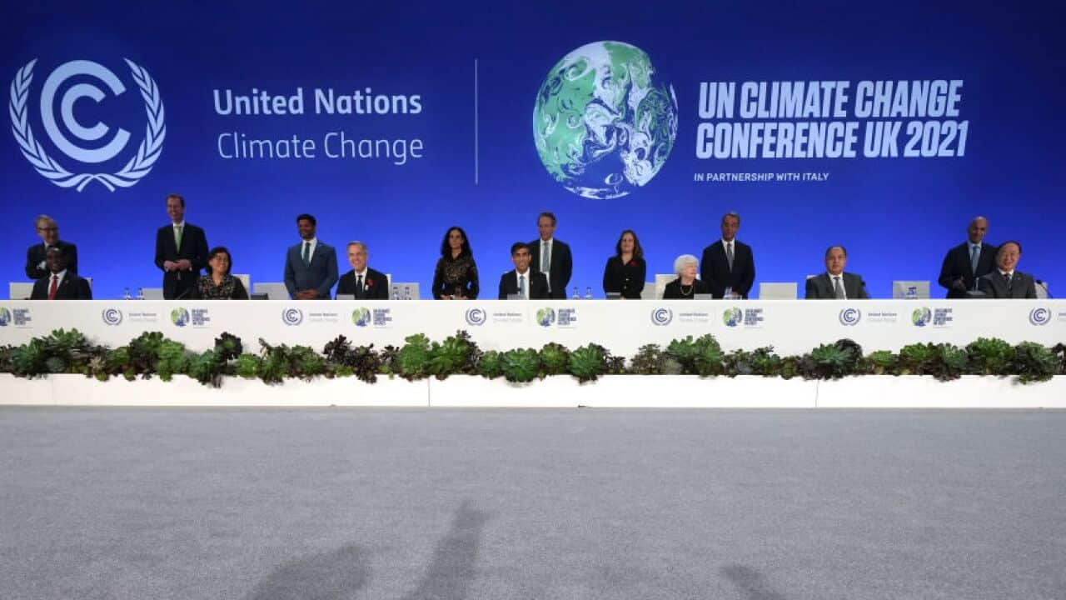
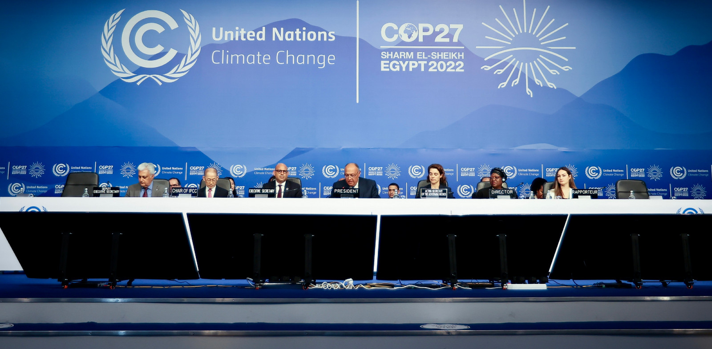
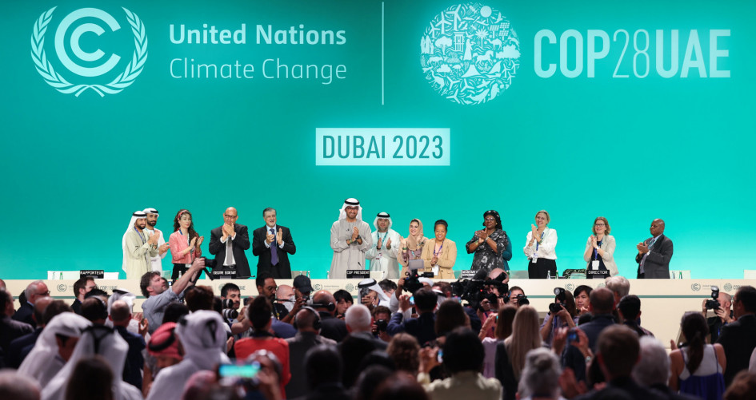
Countries have made ambitious commitments are recent COPs which they must now deliver on
KEY COMMITMENTS FROM RECENT COPs
Triple renewables by 2030
Double rate of energy efficiency improvements by 2030
Halt and reverse deforestation and land degradation by 2030
Reduce global methane emissions by 30% by 2030
Achieve near-zero methane emissions from oil and gas production by or before 2050

Slide 15
Overall ambition in upcoming NDCs could be 3x higher if they reflected technological progress, and sectoral and national commitments
GHG emissions mitigation by lever
GtCO₂e
Renewables
Energy Efficiency
Industrial CCUS
Pledges on Food, Land Use
EV Deployment
Industry Sector Projects and Pledges
Pledges on Methane
~11
Delivery of current “NDC 2.0” targets
Clearly feasible ambition in “NDCs 3.0”
~1
~6
3X
38
Pledges on deforestation, food, land use are highly uncertain and currently lack funding and policies
2035 - Baseline^{i}
Mature clean energy technologies
Hard –to-abate sectors
Implementation of national non-energy commitments
2035 - Potential
Remaining Gap
2035 - Required for 1.5°C^{i}
Notes: [i] Estimates are taken from UNEP (2023), Emissions Gap Report: Broken Record, mitigation from renewables and energy efficiency assumes the full implementation of global pledge to triple renewable capacity and double annual energy efficiency improvements by 2030 made at COP28, mitigation from hard-to-abate sectors excludes the decarbonisation of power supply which is considered under “Mature clean energy technologies”. Mitigation from “Pledges on Methane” include the impact of both the Global Methane Pledge (GMP) and the Oil and Gas Decarbonization Charter (OGDC) and overlap, methane emissions from agriculture under GMP are considered in “Pledges on Food, Land Use”. Projections include all GHGs, but estimates of mitigation levers focus on CO₂ and CH₄ emissions.
Sources: Systemiq analysis for the ETC, based on ETC (2023), Fossil Fuels in Transition; ETC (2023), COP28: A High-Level Assessment of Mitigation Proposals; IEA (2023), Net Zero Roadmap – Update; IEA (2023), World Energy Outlook; IEA (2023), Global EV Data Explorer; IEA (2024), CCUS Projects Database; BNEF (2024), Interactive Data Tool – Capacity; BNEF (2023), Long-Term Electric Vehicle Outlook; BNEF (2023), CCUS Projects Database; Mission Possible Partnership Sector Transition Strategies; IPCC (2023), Synthesis Report Of The IPCC Sixth Assessment Report (AR6).

Slide 16
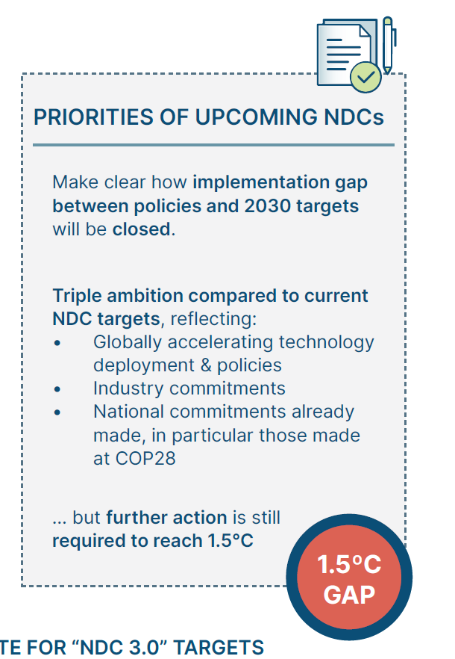
This would put the world on track for 2°C
Historical¹
“NDCs 2.0” all targets
Global GHG emissions
GtCO₂e p.a.
Current policies²
2°C Pathway^{2,i,iii}
“NDCs 2.0” unconditional targets²
1.5°C Pathway^{2,ii,iii}
Implementation gap
Clearly feasible ambition in “NDCs 3.0”
3X
Gap to 1.5°C
Notes: [i] Based on IPCC Working Group III Sixth Assessment Report scenario class c1 (limit warming to 1.5°C (>50%) with no or limited overshoot). [ii] Based on IPCC Working Group III Sixth Assessment Report scenario class c3 (limit warming to 2°C (>67%)). [iii] Range corresponds to range between tenth and ninetieth percentile, central line corresponds to median.
Sources: Systemiq analysis for the ETC based on [1] IPCC (2022), Metadata Browser: Data for Figure SPM.5 - Summary for Policymakers of the WGIII Contribution to the IPCC AR6, [2] UNEP (2023), Emissions Gap Report: Broken Record.

Slide 17
But ambition alone will not translate into progress: clear NDC targets and information on how they will be delivered, including investment required, will reinforce their role as roadmaps for climate action
Category | Current NDCs | Ideal NDCs 3.0
Ambition | Does not reflect reality of technology deployment | Reflect pace of technological progress & ambition implied by delivery of COP commitments
Format and coverage | Unclearly defined targets with partial coverage | Absolute reduction targets (or equivalent) covering all sectors & GHGs
Implementation | Lack of details on policies required to achieve targets | Clear link between stated targets and policies required to achieve them
Outcomes
Ambitious yet clearly feasible ambition
Increased transparency of target
Clear, investable plans to deliver stated ambition
Note: comparison to current NDCs applies to most but not all NDCs. Listed countries are broad examples to which current NDC shortcomings apply.

Slide 18













NDCs can be broadly categorised against ambition and implementation
 |  |  | Share of global GHG emissions | Ambition |  |  |  | Implementation
 |  |  |  | Type of target | Conditionality | Sector and GHG coverage | CAT assessment on level of ambition (least cost vs. fair share) | Sufficient information to support target implementation | Existing national decarbonisation strategies | Existing climate policies are reflected in NDCs
Archetype 1 Clearly defined ambition, unclear implementation |  |  | 30% | Absolute | Unconditional | Complete |  | No | Yes | No
Archetype 2 Unclear ambition & implementa-tion | 2.A | 2.A | 66% | Variable – Relative to BAU or intensity-based | Mostly unconditional | Partial |  | No | Yes | No
 | 2.B | 2.B |  | Variable – Relative to BAU or intensity-based | Mostly unconditional | Partial |  | No | No | No
Archetype 3 Clear ambition & implementation, support required for delivery |  |  | 4% | Relative to BAU | Mostly conditional | Complete |  | Yes | Yes | Yes
EU
US
Ja
No
Ca
Br
Ch
In
Arg
SA
NZ
Et

Slide 19
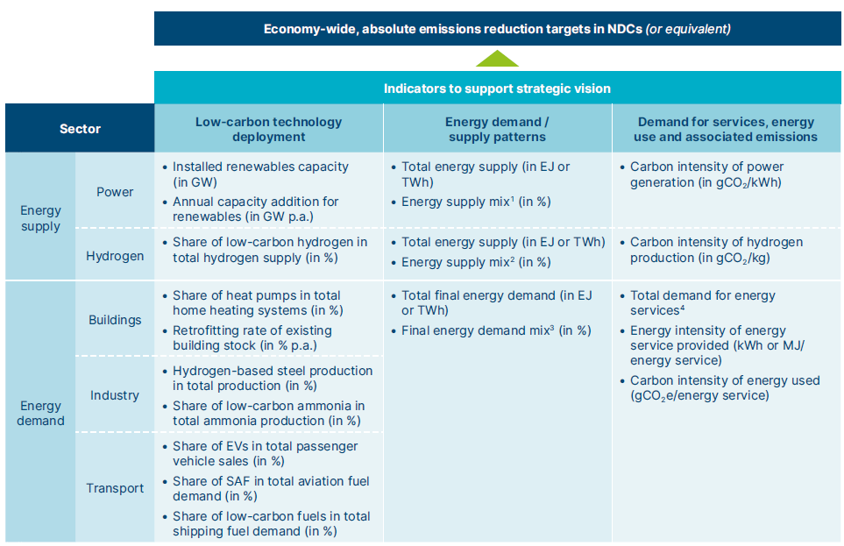
NDC targets should be underpinned by a clear strategic vision of how the energy system will transition over time – NDCs could include several indicators to reflect this understanding and track progress

Slide 20
What is needed from NDCs 3.0 ?
SIGNIFICANTLY INCREASE THE AMBITION OF EMISSIONS REDUCTION TARGETS.
MAKE CLEAR HOW STATED TARGETS IN NDCS WILL BE DELIVERED, IN PARTICULAR THROUGH POLICY ACTION.
IMPROVE THE FORMAT OF TARGETS CONTAINED IN NDCS TO MAKE THEM MORE CONSISTENT, COMPREHENSIVE AND DETAILED.

